Slide 1


User Guide

Slide 2
Summary
I Login
II Project Design
III Cost-Benefits
A - Project Scoping
B - Cost Benefits
C - Dashboards
D – Comparison
1. Compare Projects
2. Compare Financial Scenarios
IV Financing
A - Funding
B - Business Model
V Settings
A - Manage Database
B - Profile

Slide 3
I Login
Back to summary

Slide 4
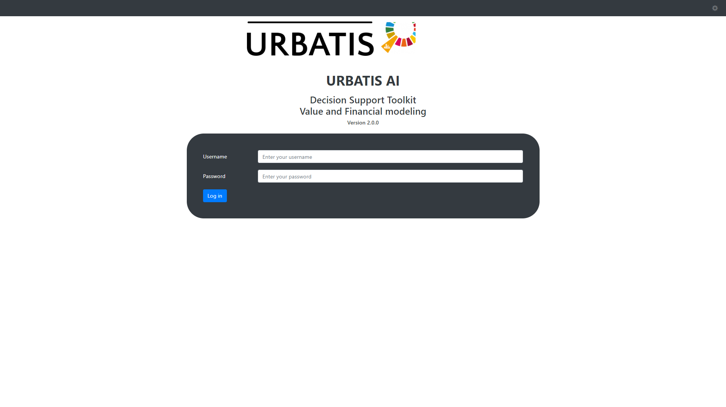
Log in with your username and password

Slide 5
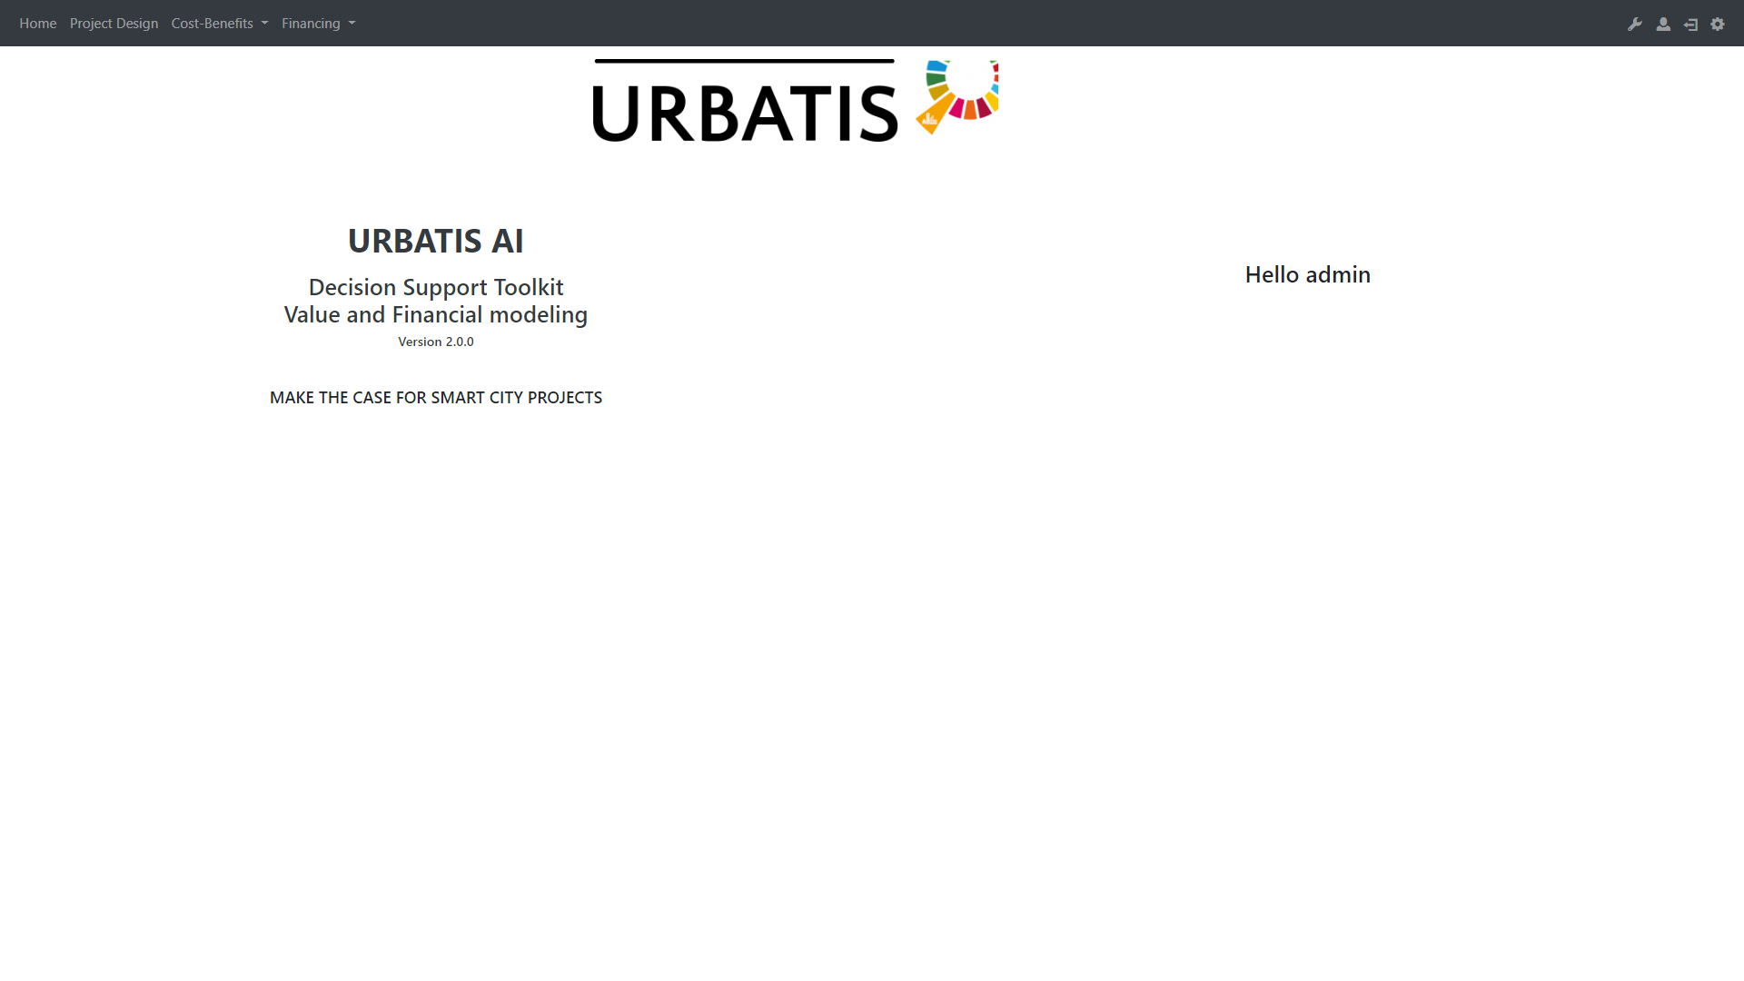
Here you have access to the settings.
This is the NavBar. It allows you to navigate through the differents parts.

Slide 6
II Project Design
Back to summary

Slide 7
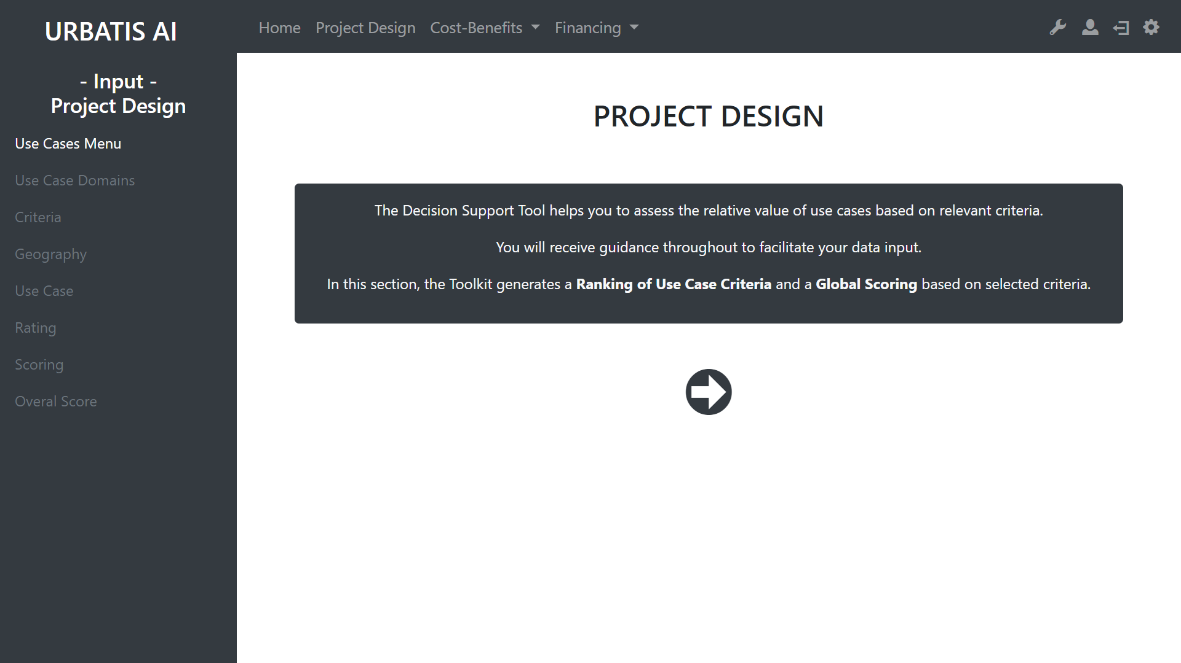
You can use this arrow to start the design.
With this sidebar you can navigate through the different sections of the project design.
However, you can only access to white links. The grey links need more information to be activated.

Slide 8
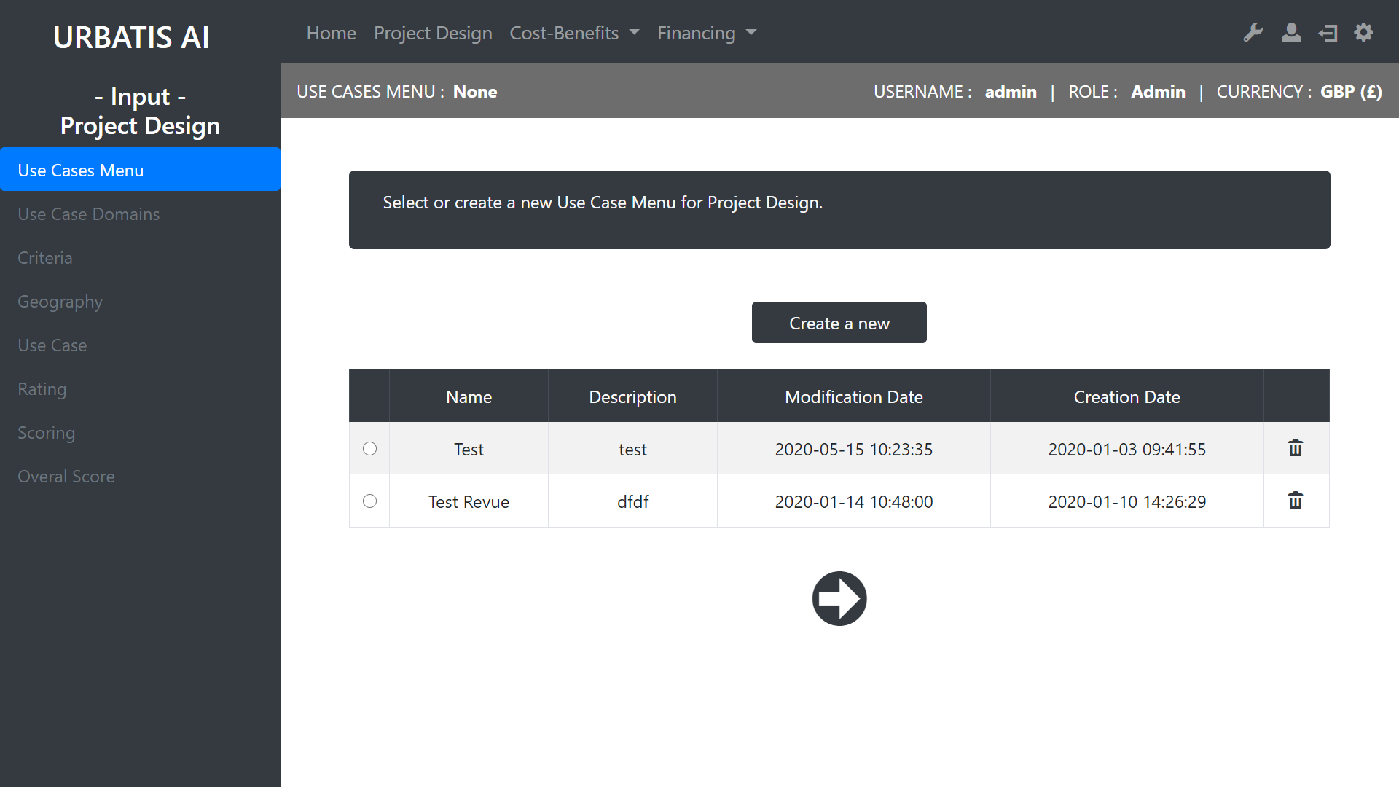
To design your Use Case Menu , you need to select one existing or to create a new one.
Creat a new Use Case
Review of existing Use Case
Drop the Use Case
Go to the next step

Slide 9
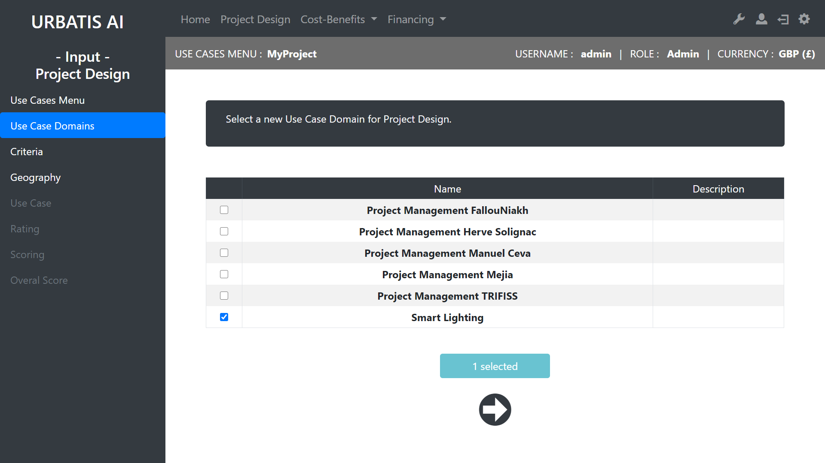
Once the project is selected, there more active links (in white)
Selection of domains for the Use Case
Go to the next step

Slide 10
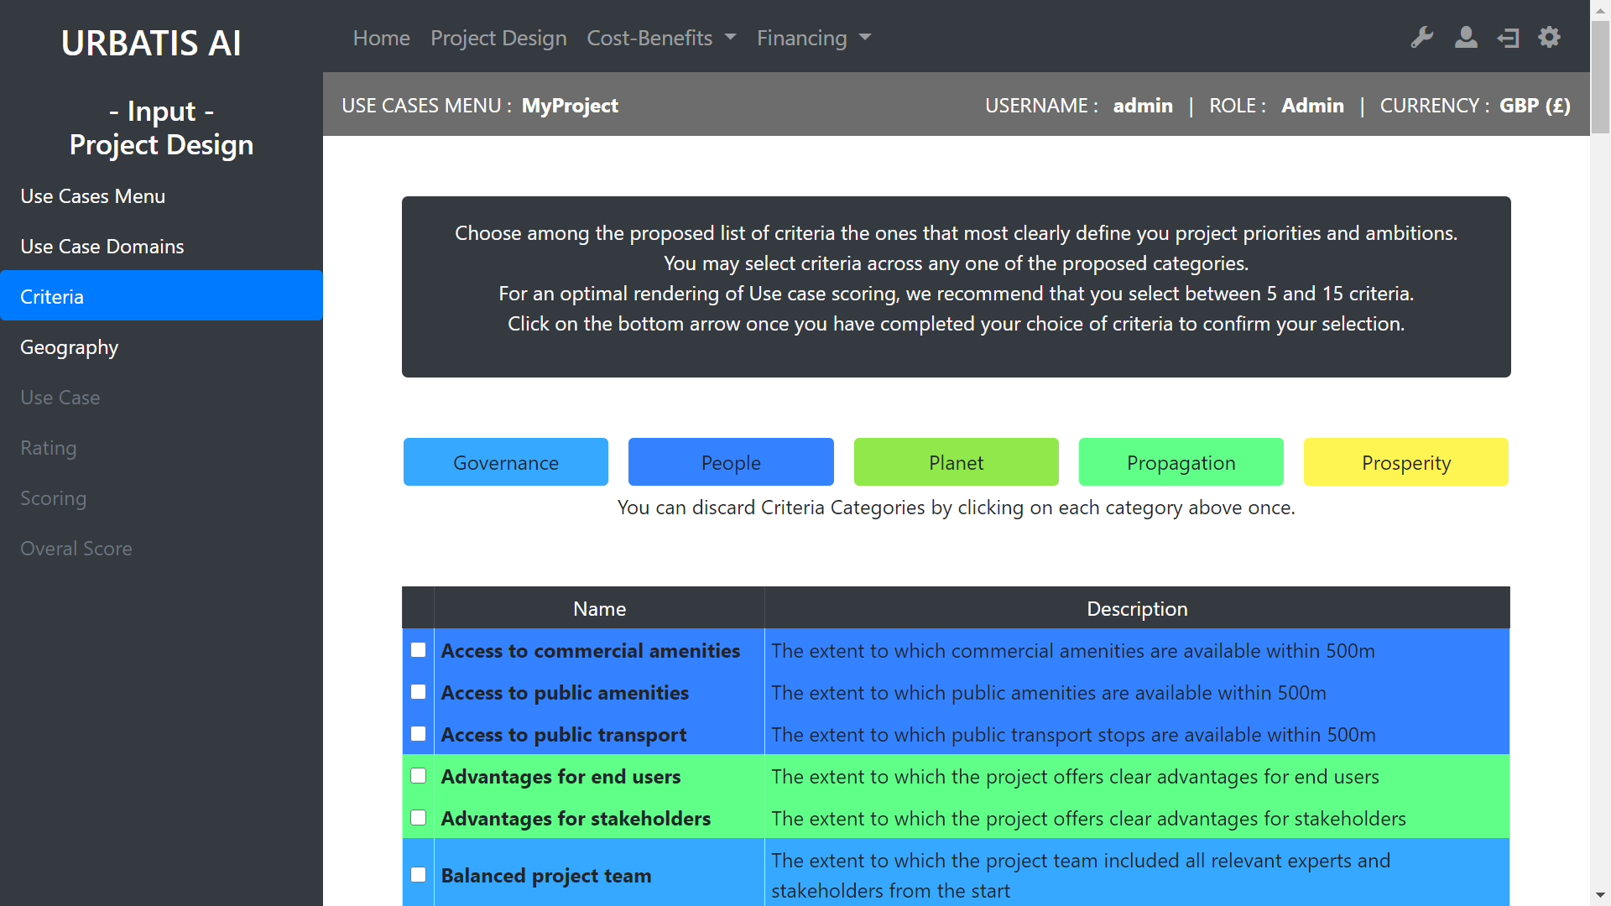
You can discard some criteria categories by clicking on each category.

Slide 11
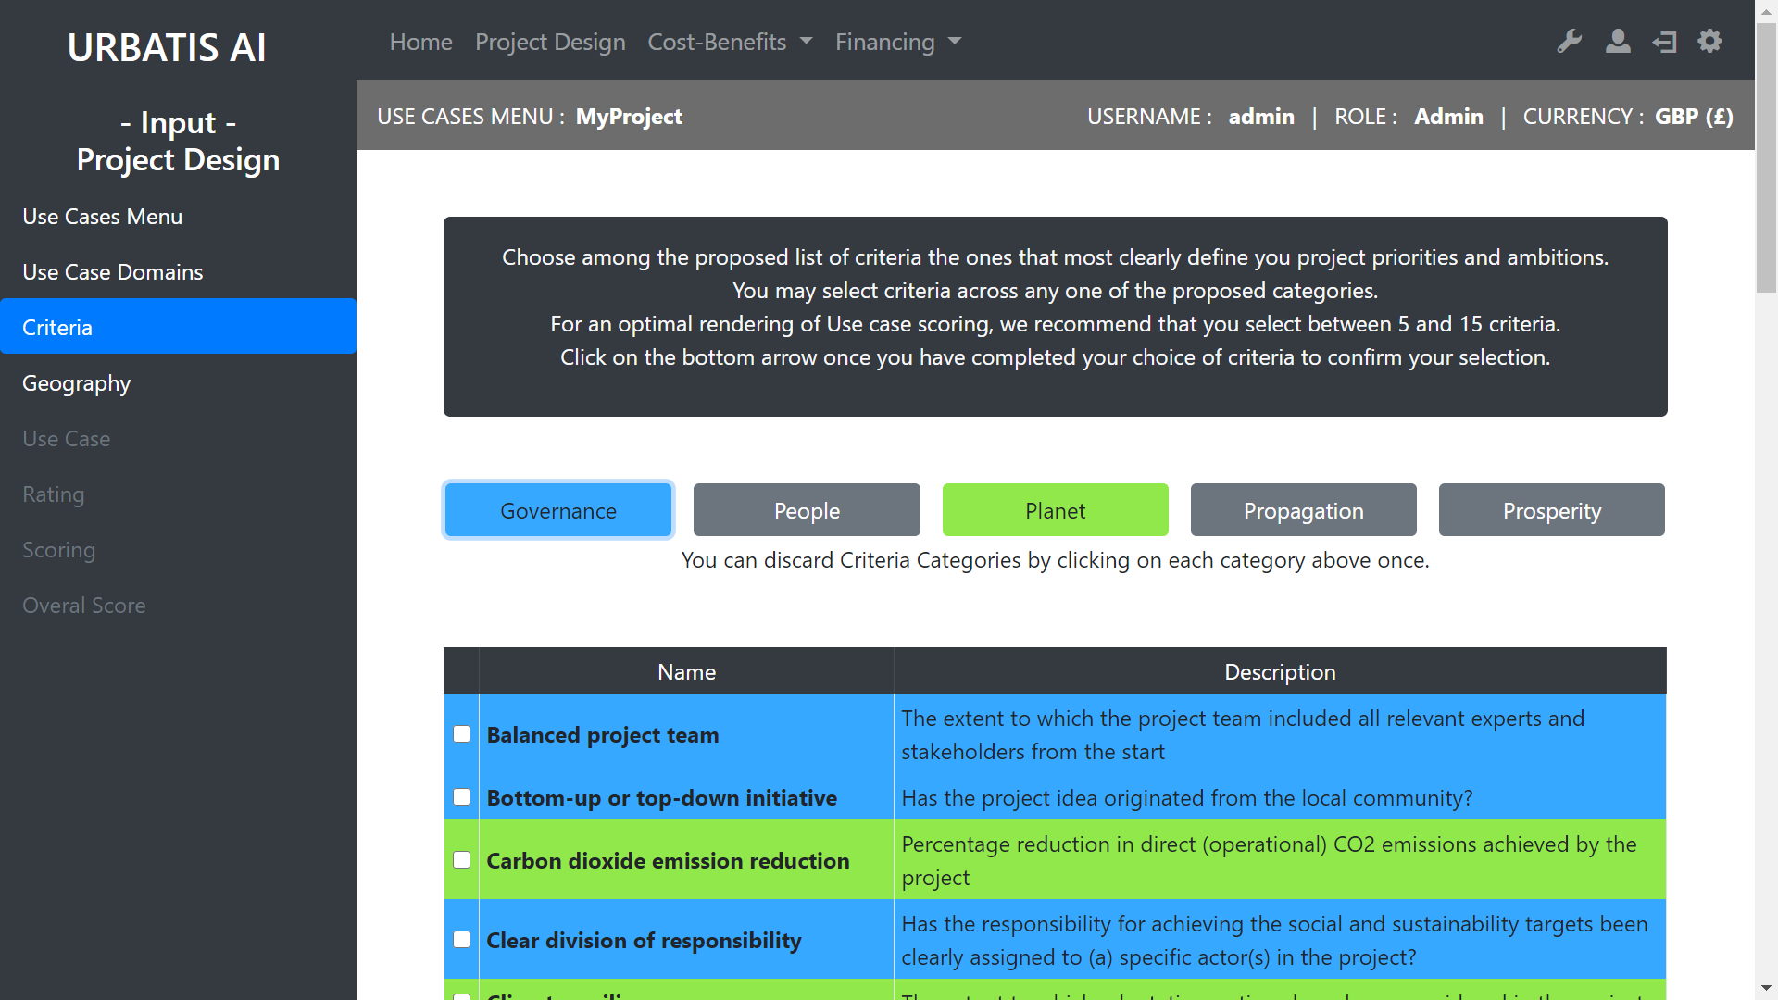
The discarted categories are now missing from the list.

Slide 12
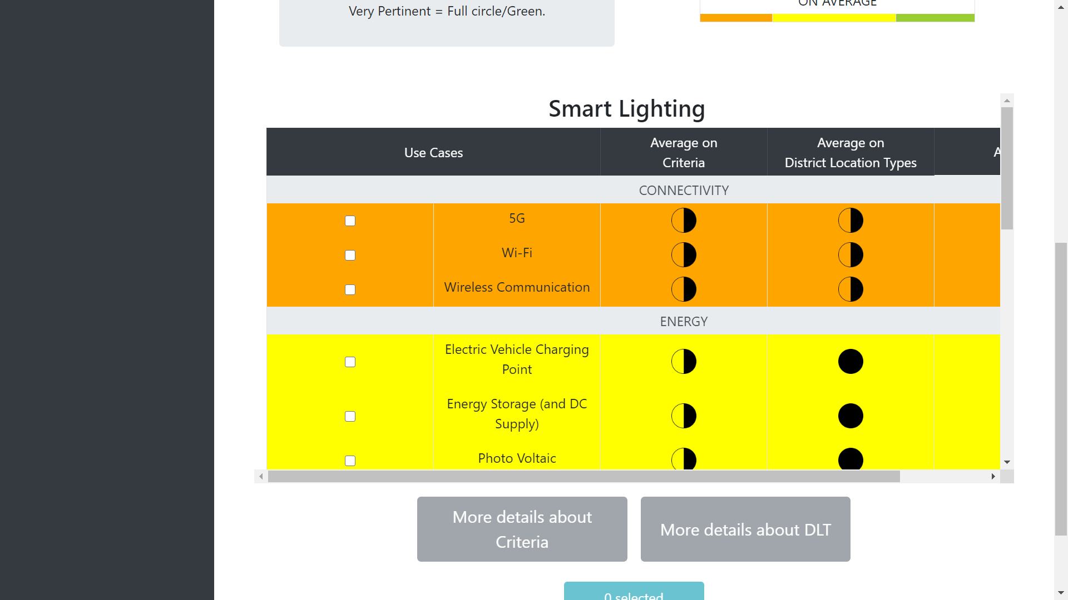
Summary of different solutions :
If you want more details
Use case

Slide 13
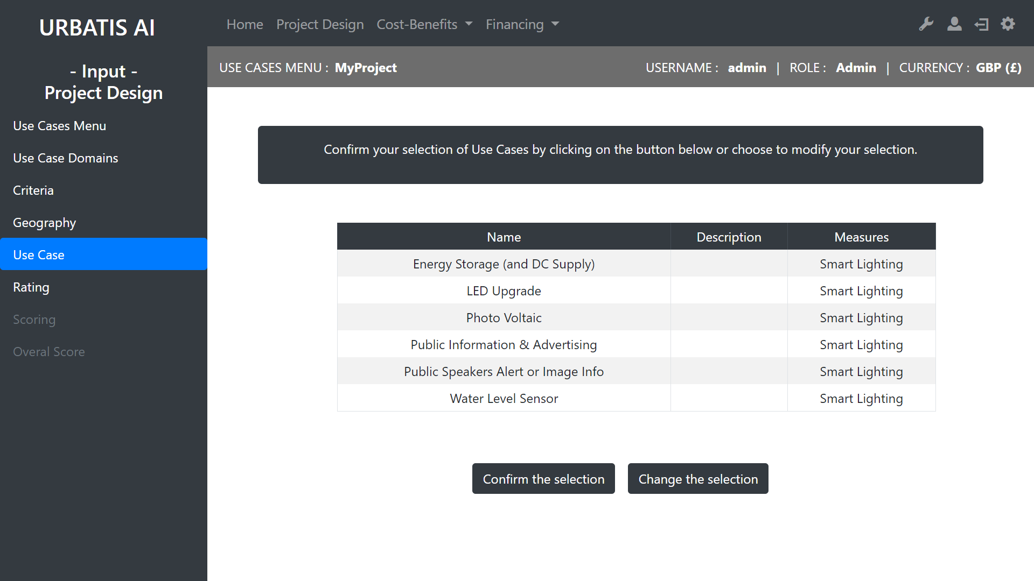
Review of the solutions selected
You can change or confirm your selection

Slide 14
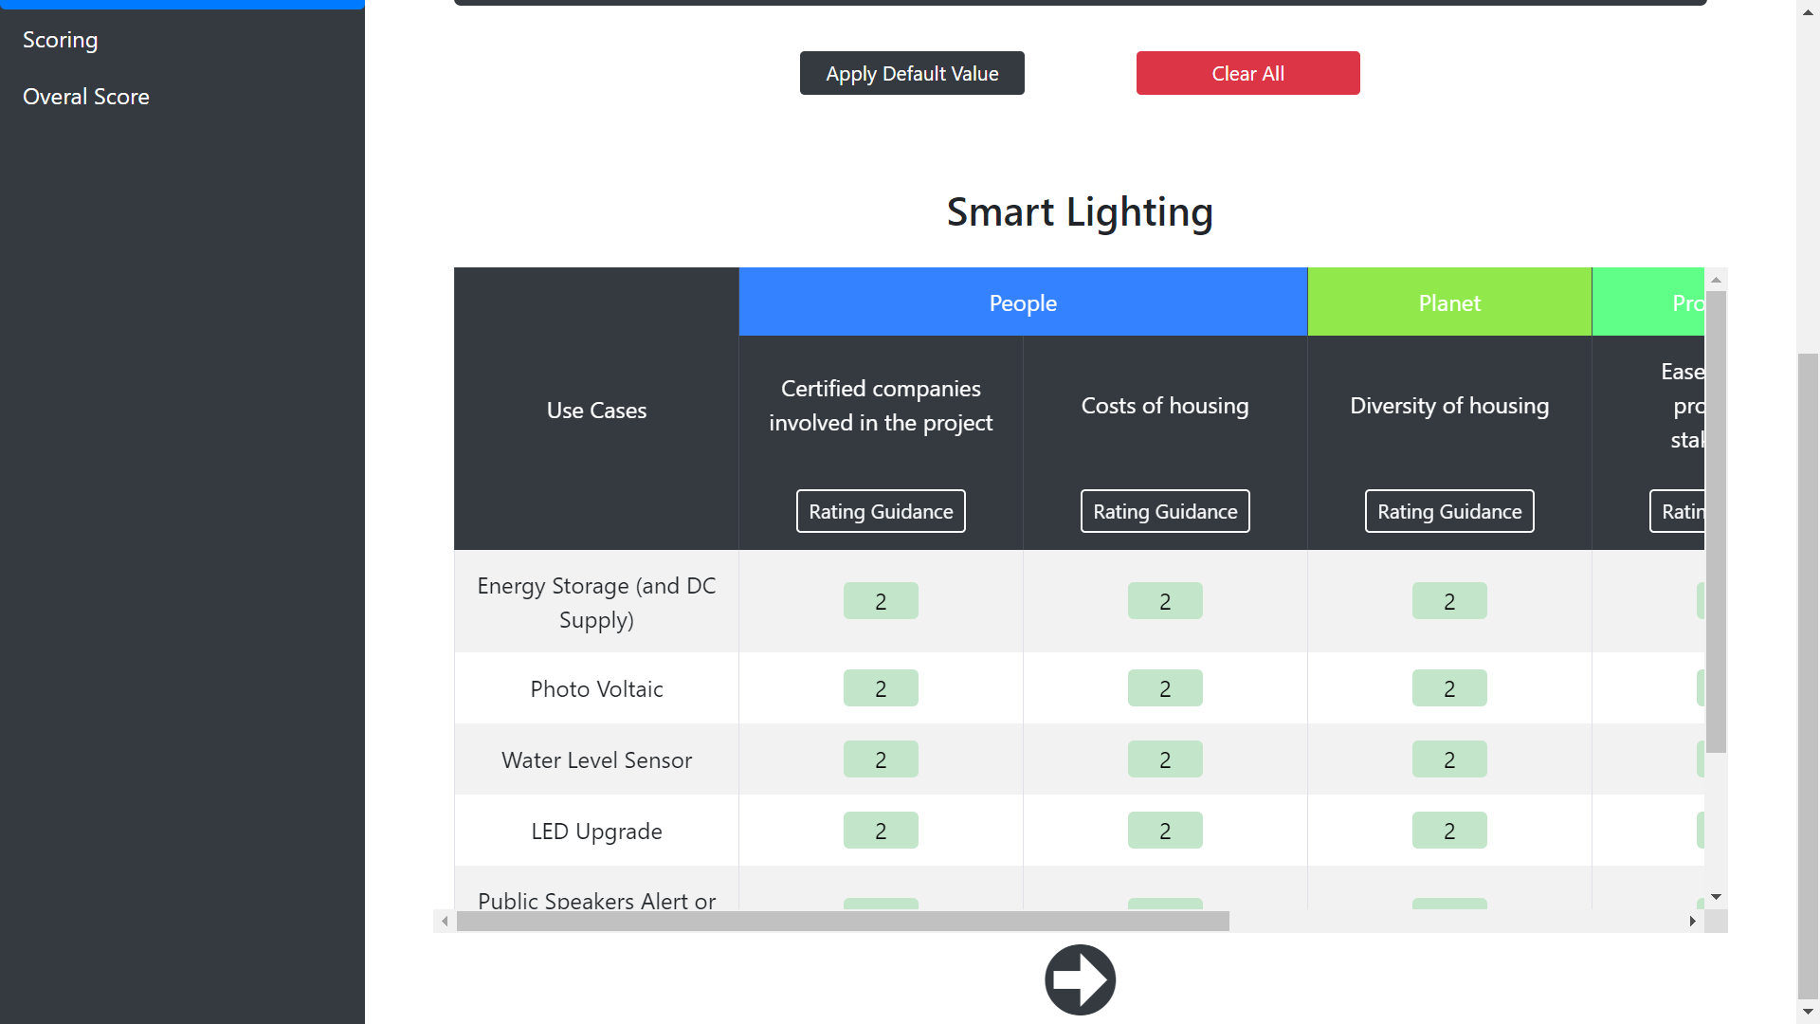
You can apply
default values from our database.
You can edit the rating values.
This will help you to understand how to edit the rates.
Ease of use for professional stakeholders
Rating

Slide 15
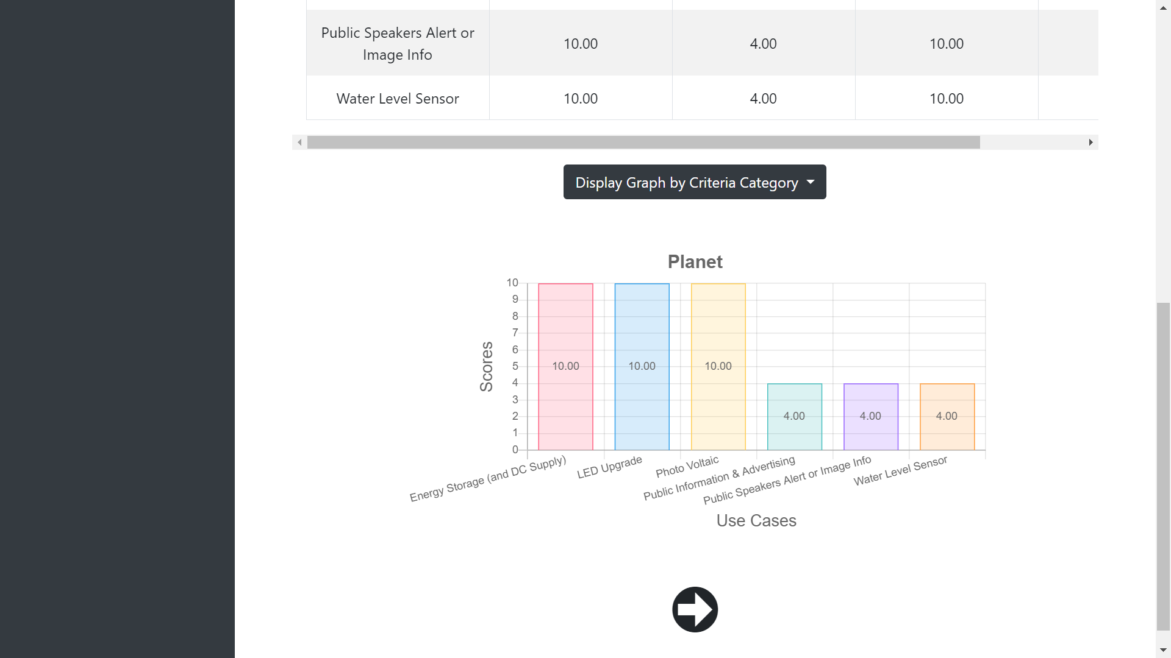
Select a graph to display.
Scoring

Slide 16
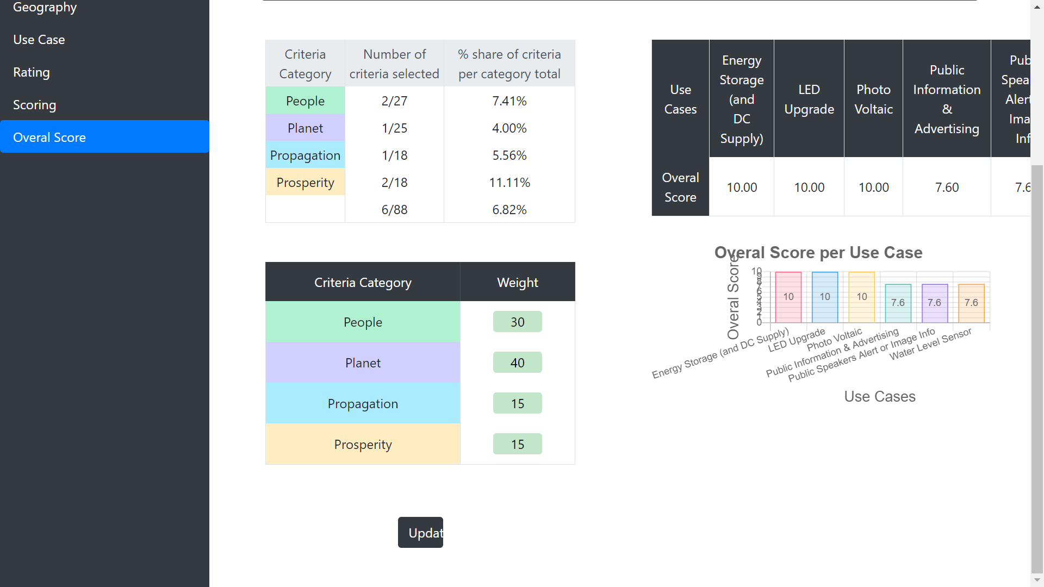
You can adjust the weigth of each criteria category.

Slide 17
III Cost-Benefits
Back to summary

Slide 18
A - Project Scoping
Back to summary

Slide 19
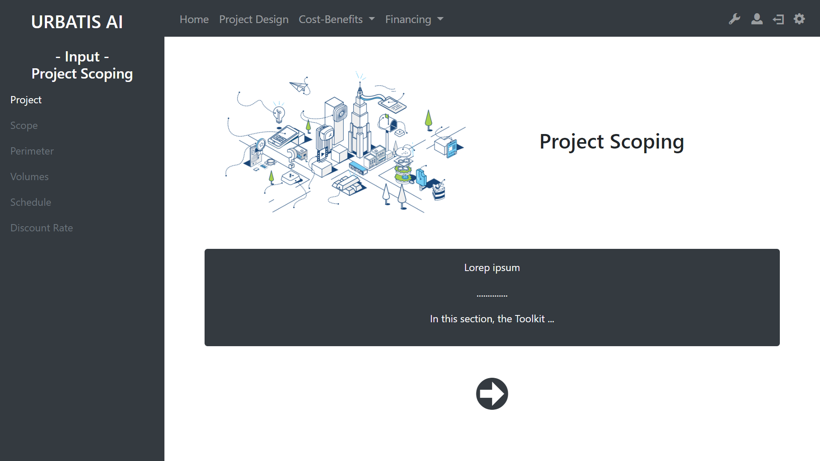
With this sidebar you can navigate through the different sections of the project scoping.
However, you can only access to white links. The grey links need more information to be activated.
You can use this arrow to start the project scoping.

Slide 20
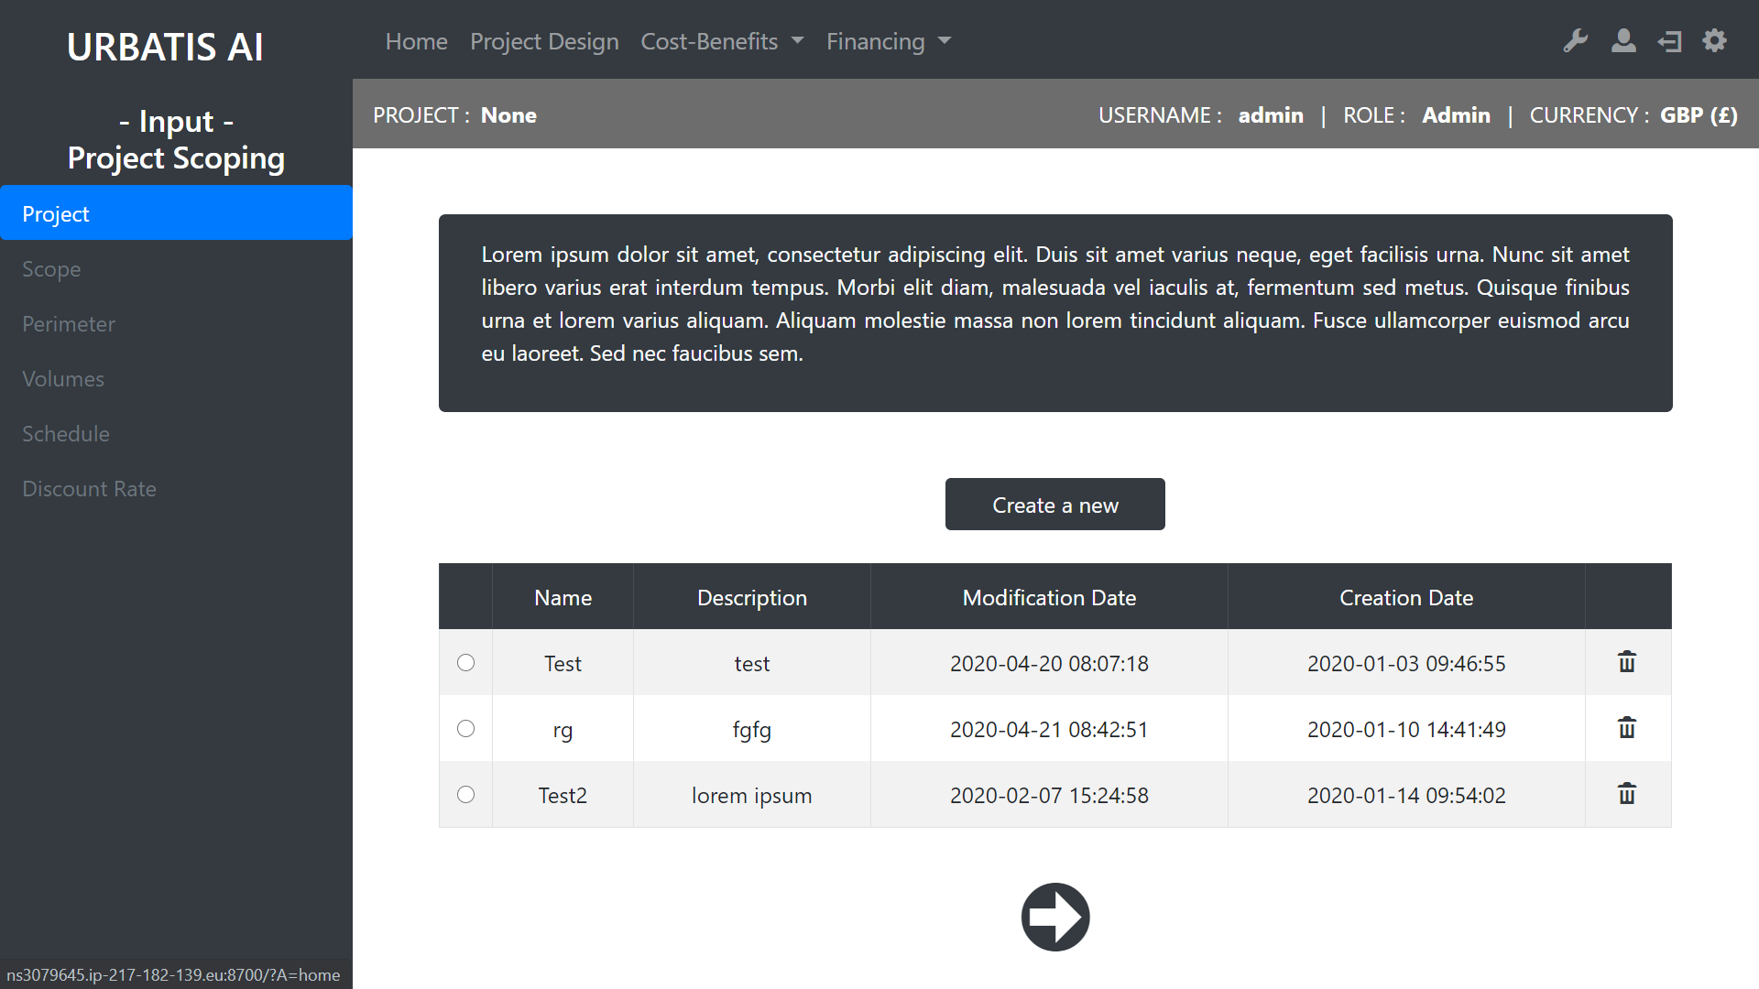
You need to select an existing project or to create a new one.
Creat a new project
Review of the existing projects.
Drop the project.
Go to the next step.

Slide 21
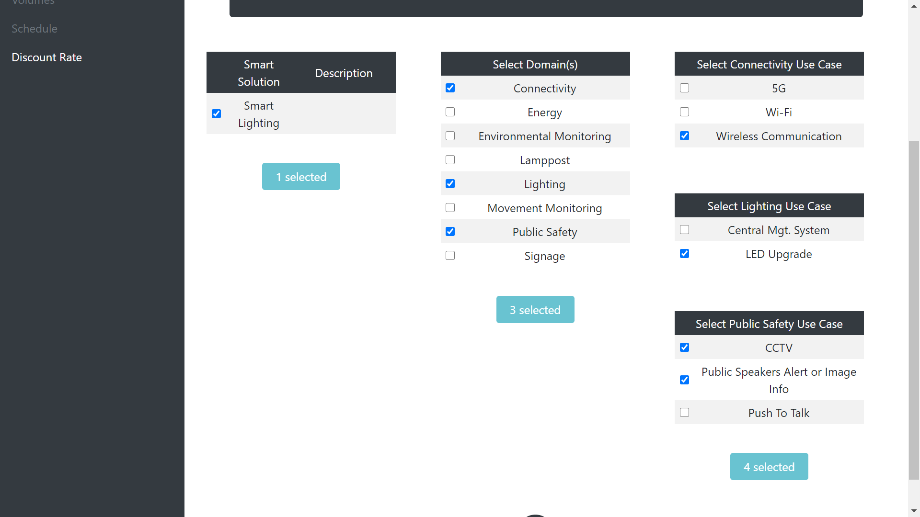
Select the scope.
Scope

Slide 22
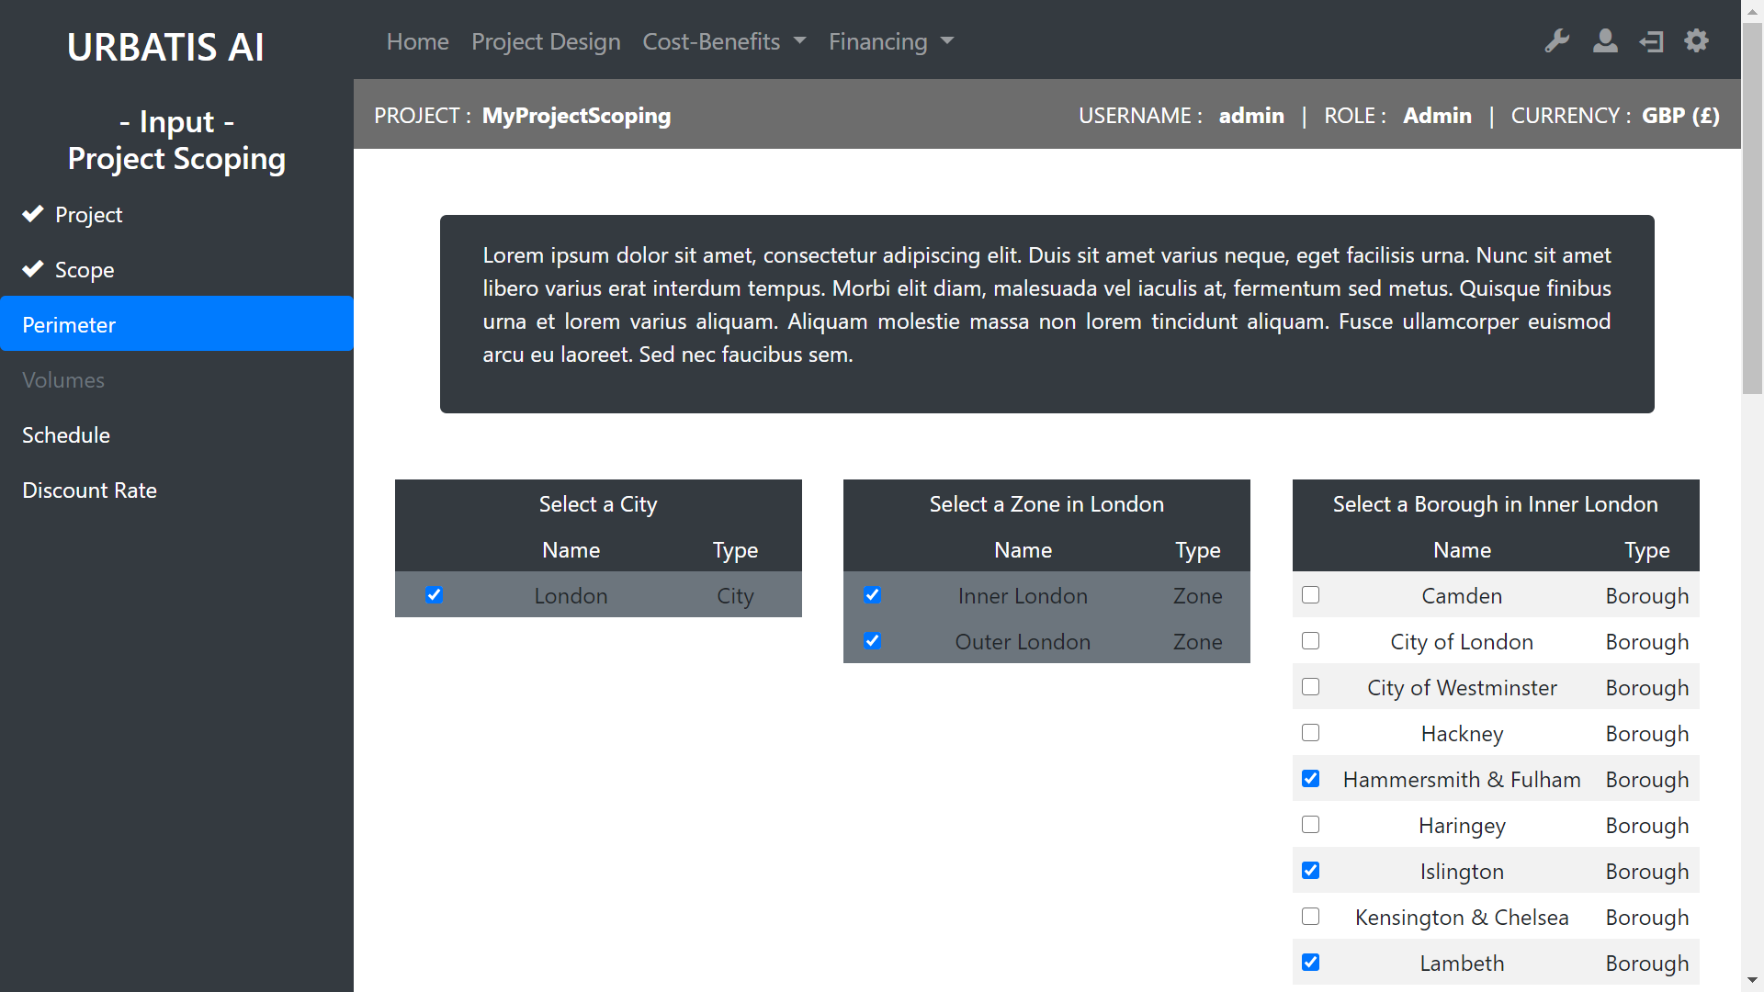
Select the Perimeter.

Slide 23
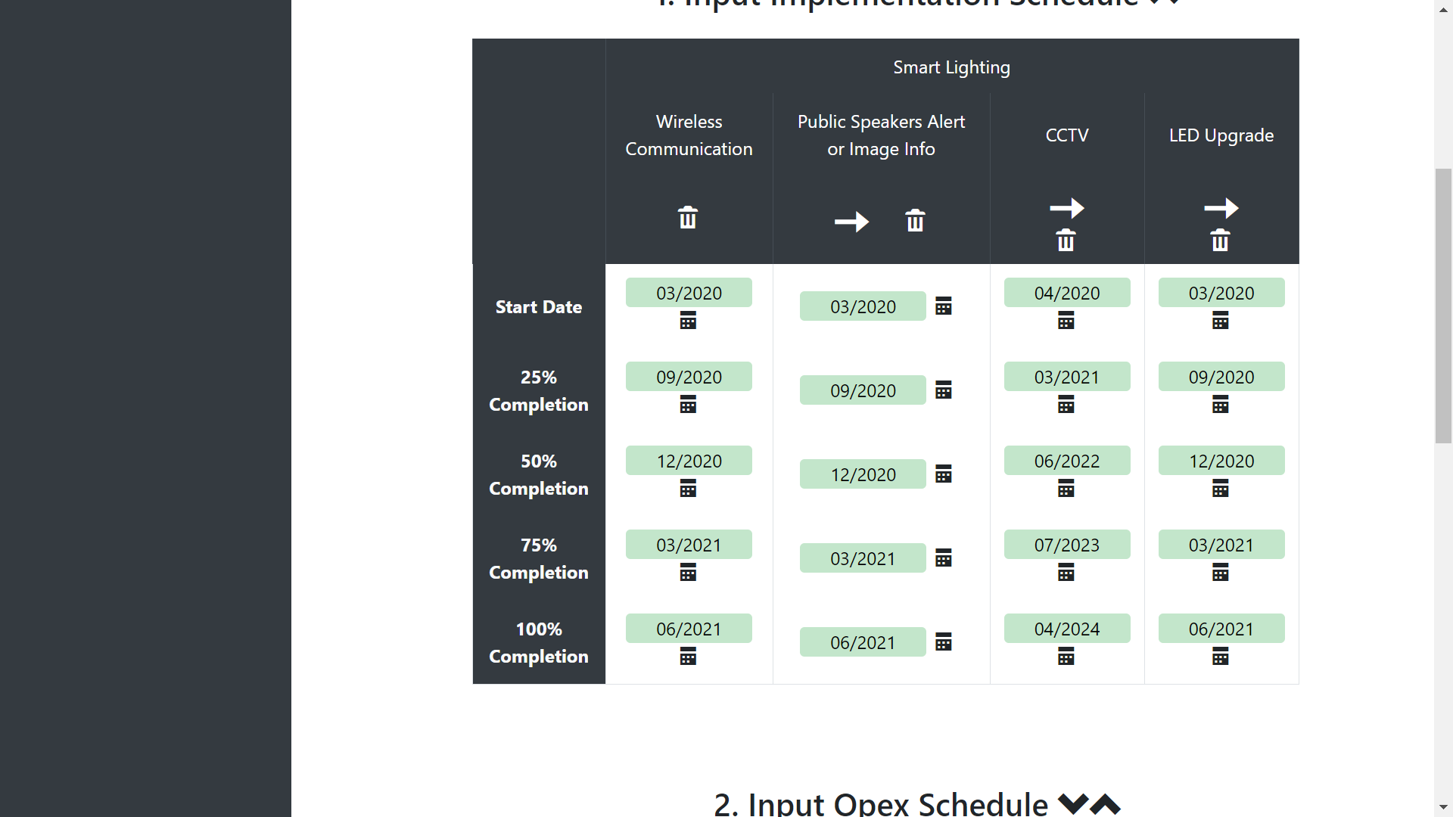
Clear the colomn
You need to edit the schedule for 3 types of input :
Implementation
Opex
Revenues Ramp-up
Be carefull, you have to select logical dates (the start date can’t be after the end date).
Copy the left colomn
Schedule

Slide 24
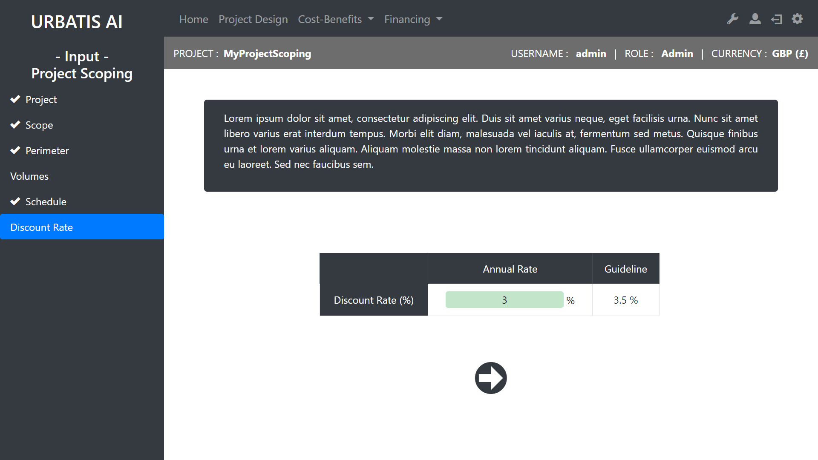
You can edit the discount rate. This rate is very important and should be chosen carfully.
You have an approximation of a good discount rate.

Slide 25
B - Cost Benefits
Back to summary

Slide 26
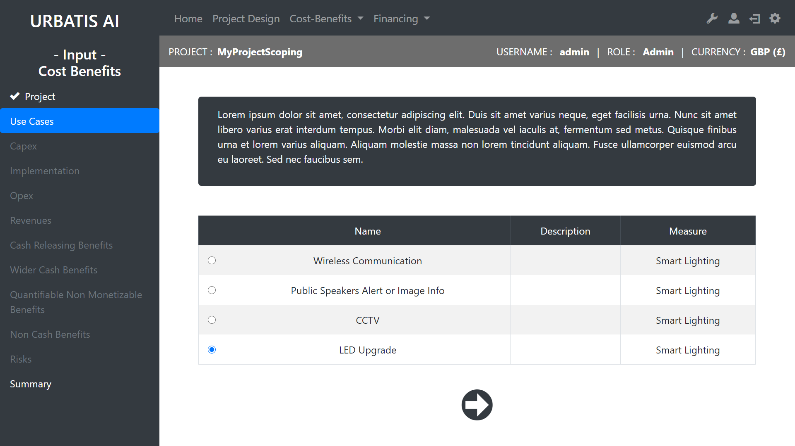
Select a Use Case to edit.

Slide 27
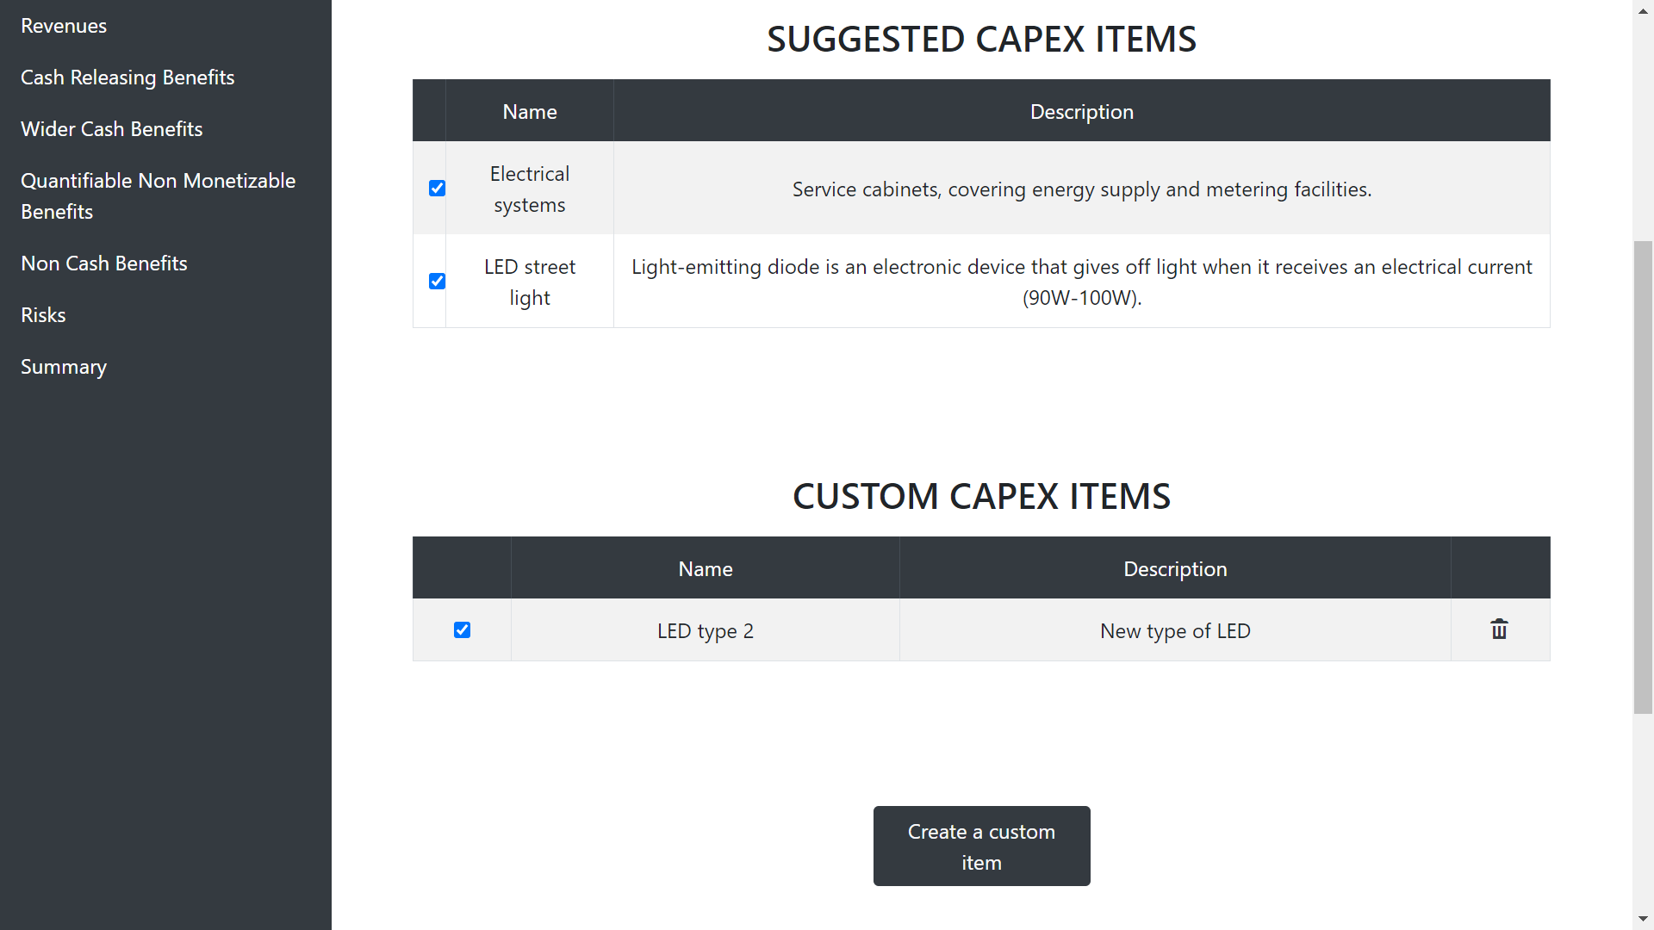
You can select suggested capex items from the database.
You can select your own capex items.
You can create your own capex items.
Capex

Slide 28
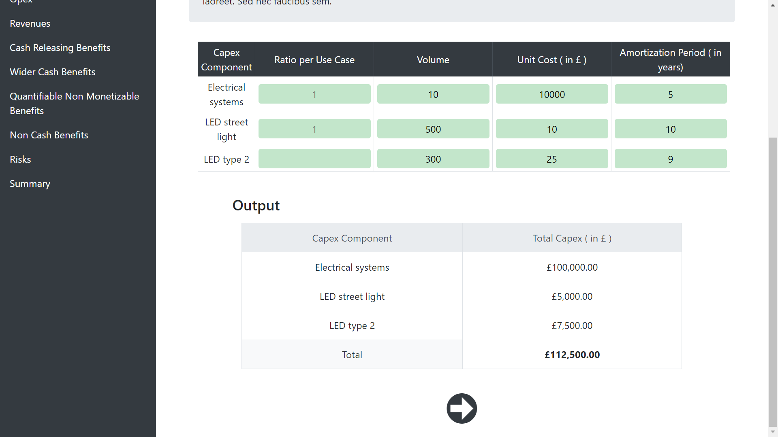
Edit this table …
… and get the capex summary.
Capex

Slide 29
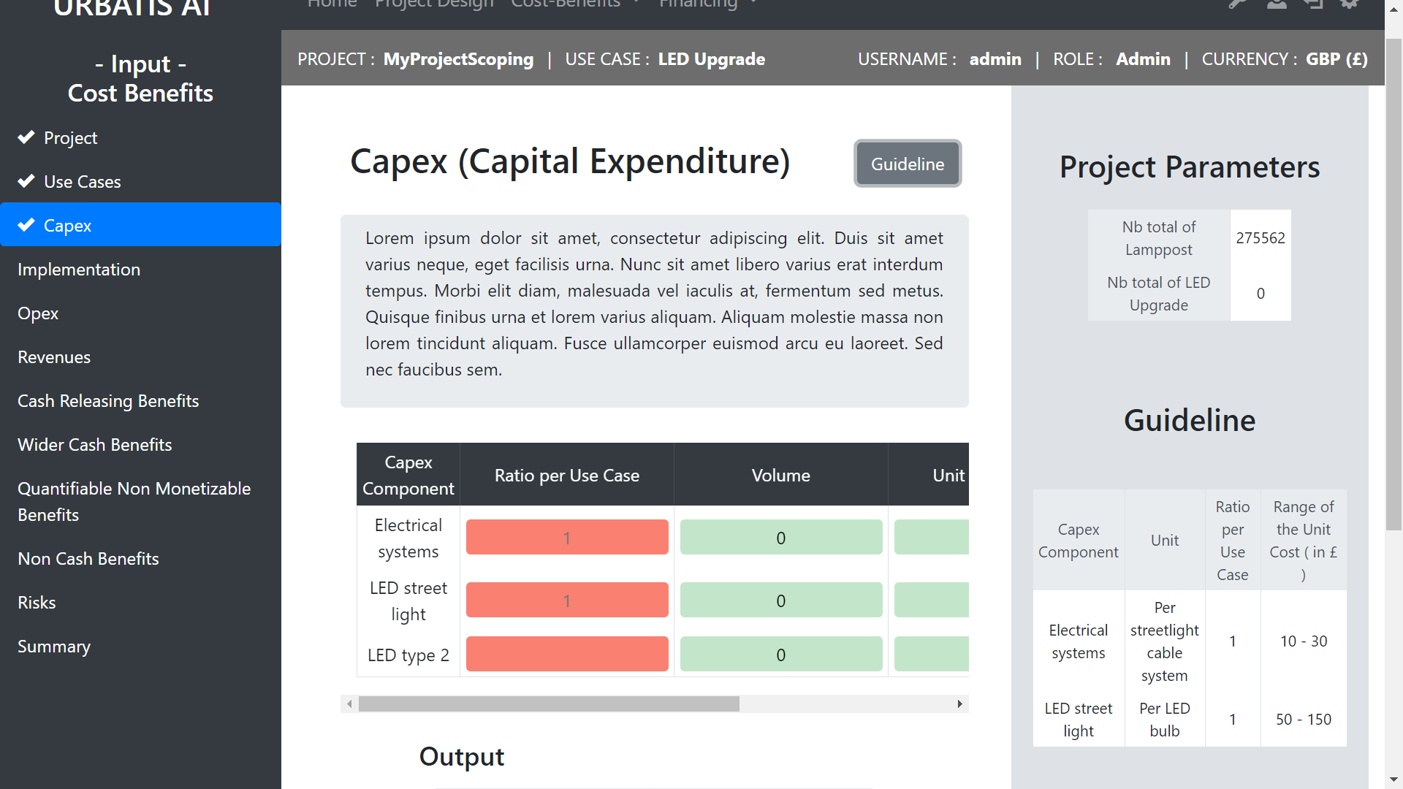
The guide line will help you to set the values of the table.

Slide 30
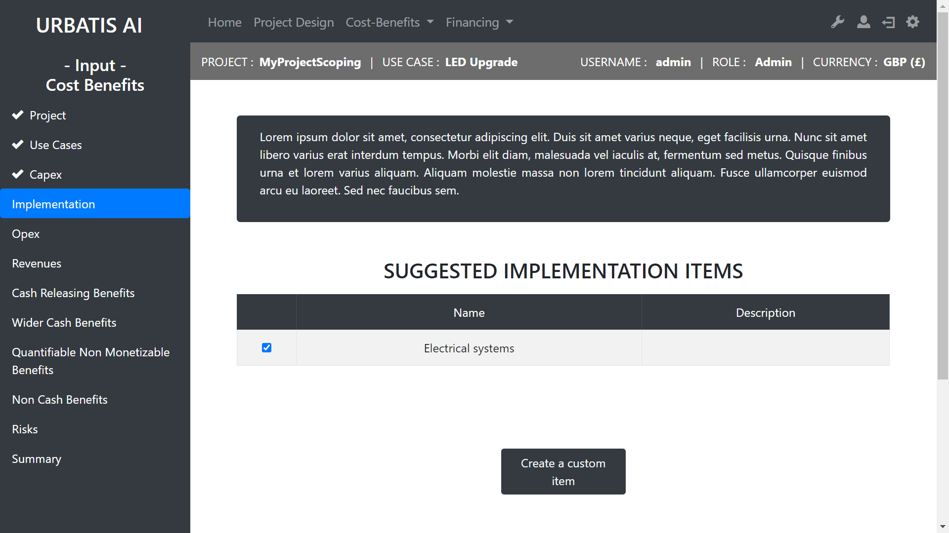
Select implementation items from our data base.
Create your own implementation item.

Slide 31
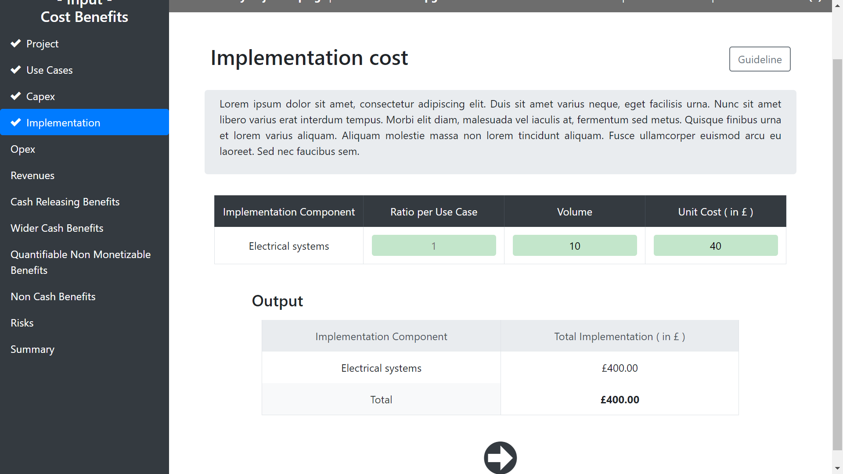
Don’t forget to look at
the guide line if you need help.
Edit this table …
… and get the implementation cost.

Slide 32
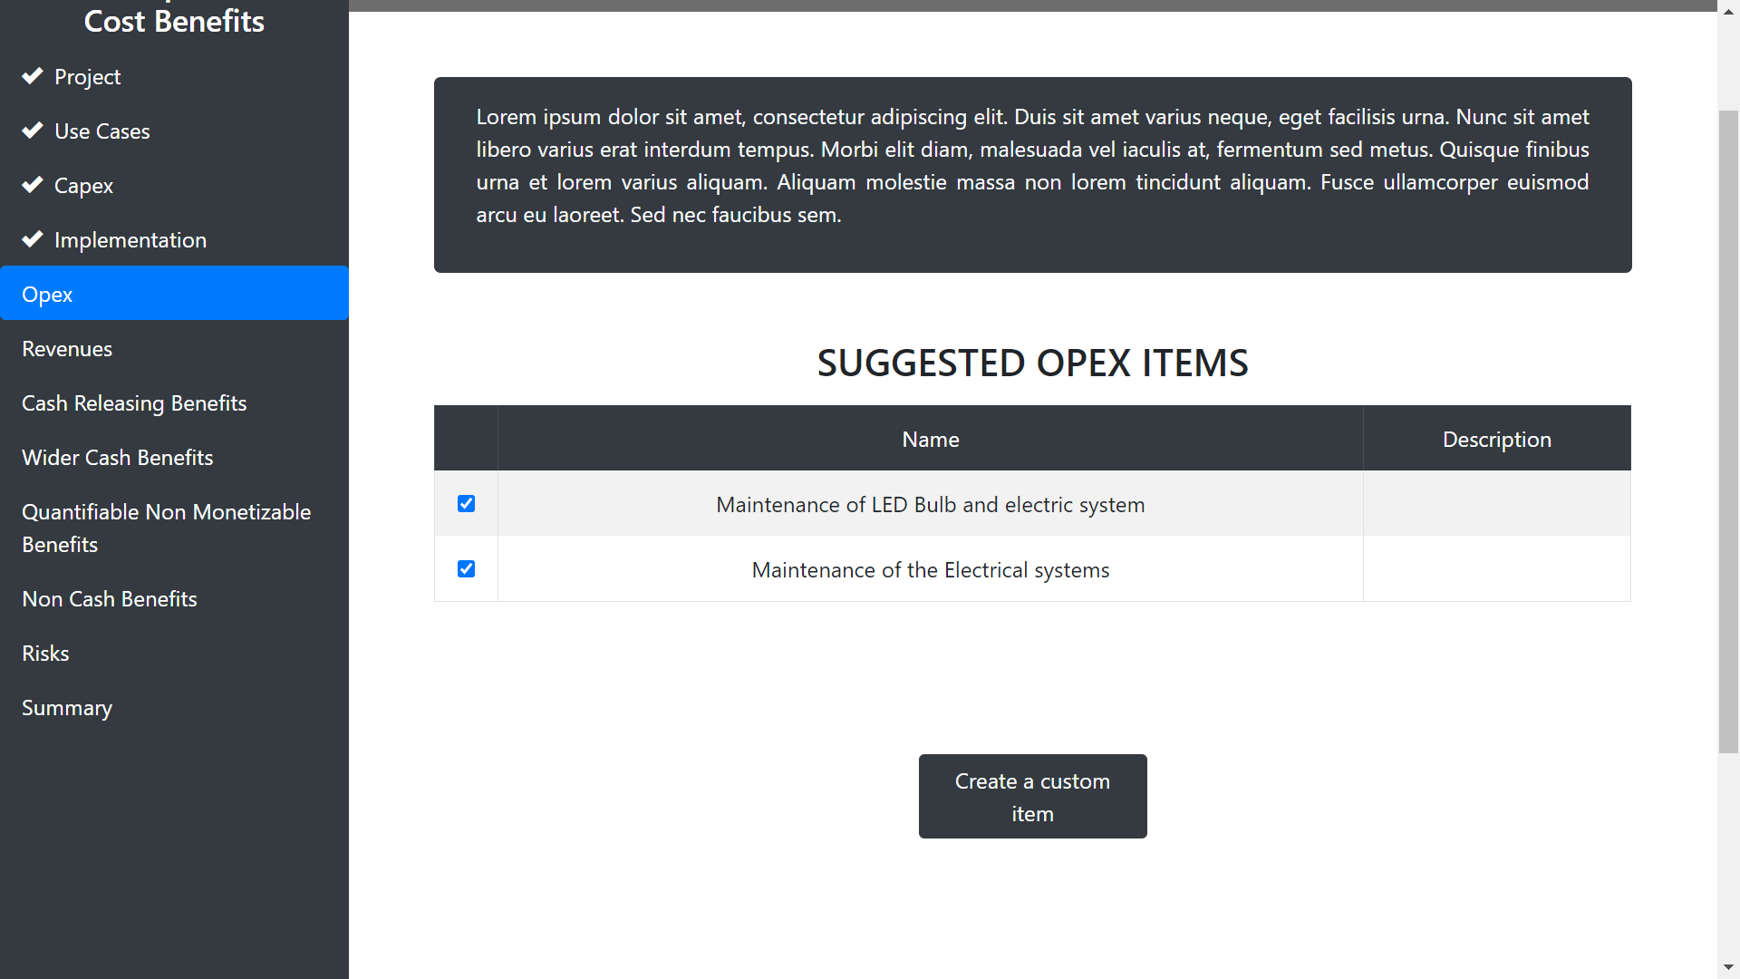
Select opex items from our data base.
Create your own opex item.

Slide 33
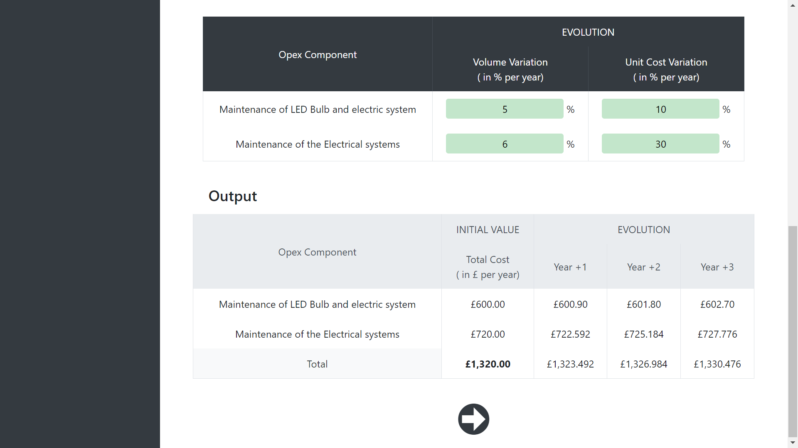
Edit this table …
… and get the opex cost.
Opex

Slide 34
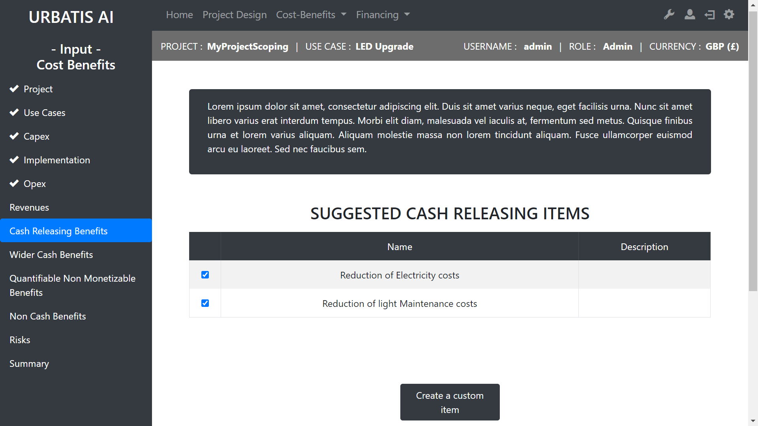
Select cash releasing items from our data base.
Create your own cash releasing item.

Slide 35
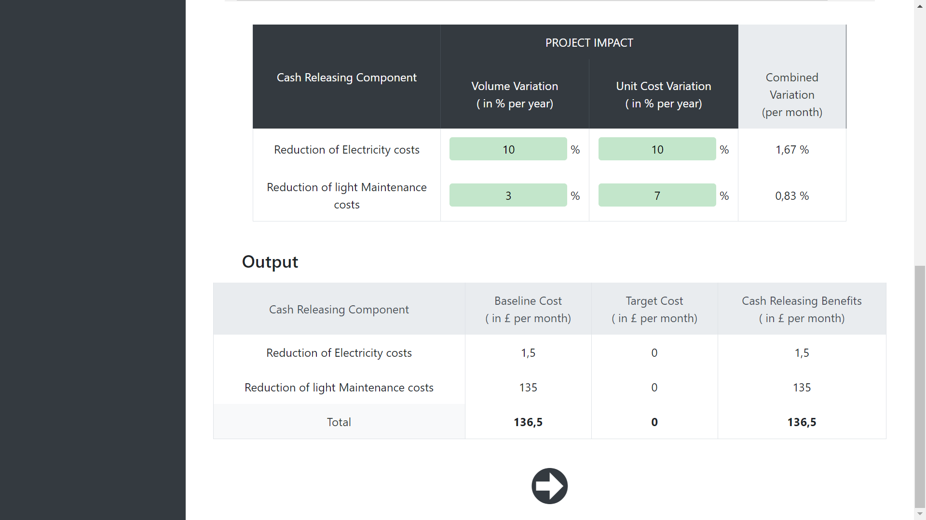
Edit this tables …
… and get the cash releasing summary.

Slide 36
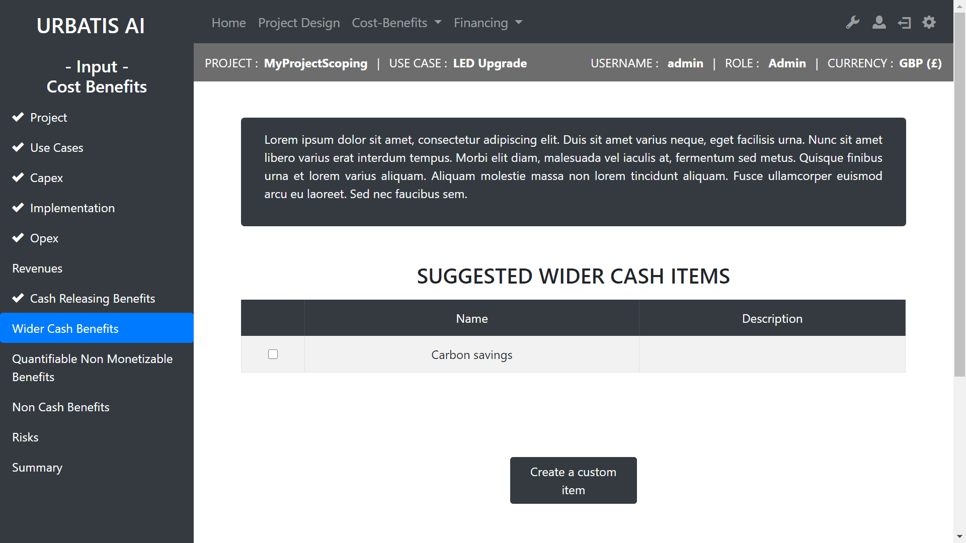
Select cash wider items from our data base.
Create your own cash wider item.

Slide 37
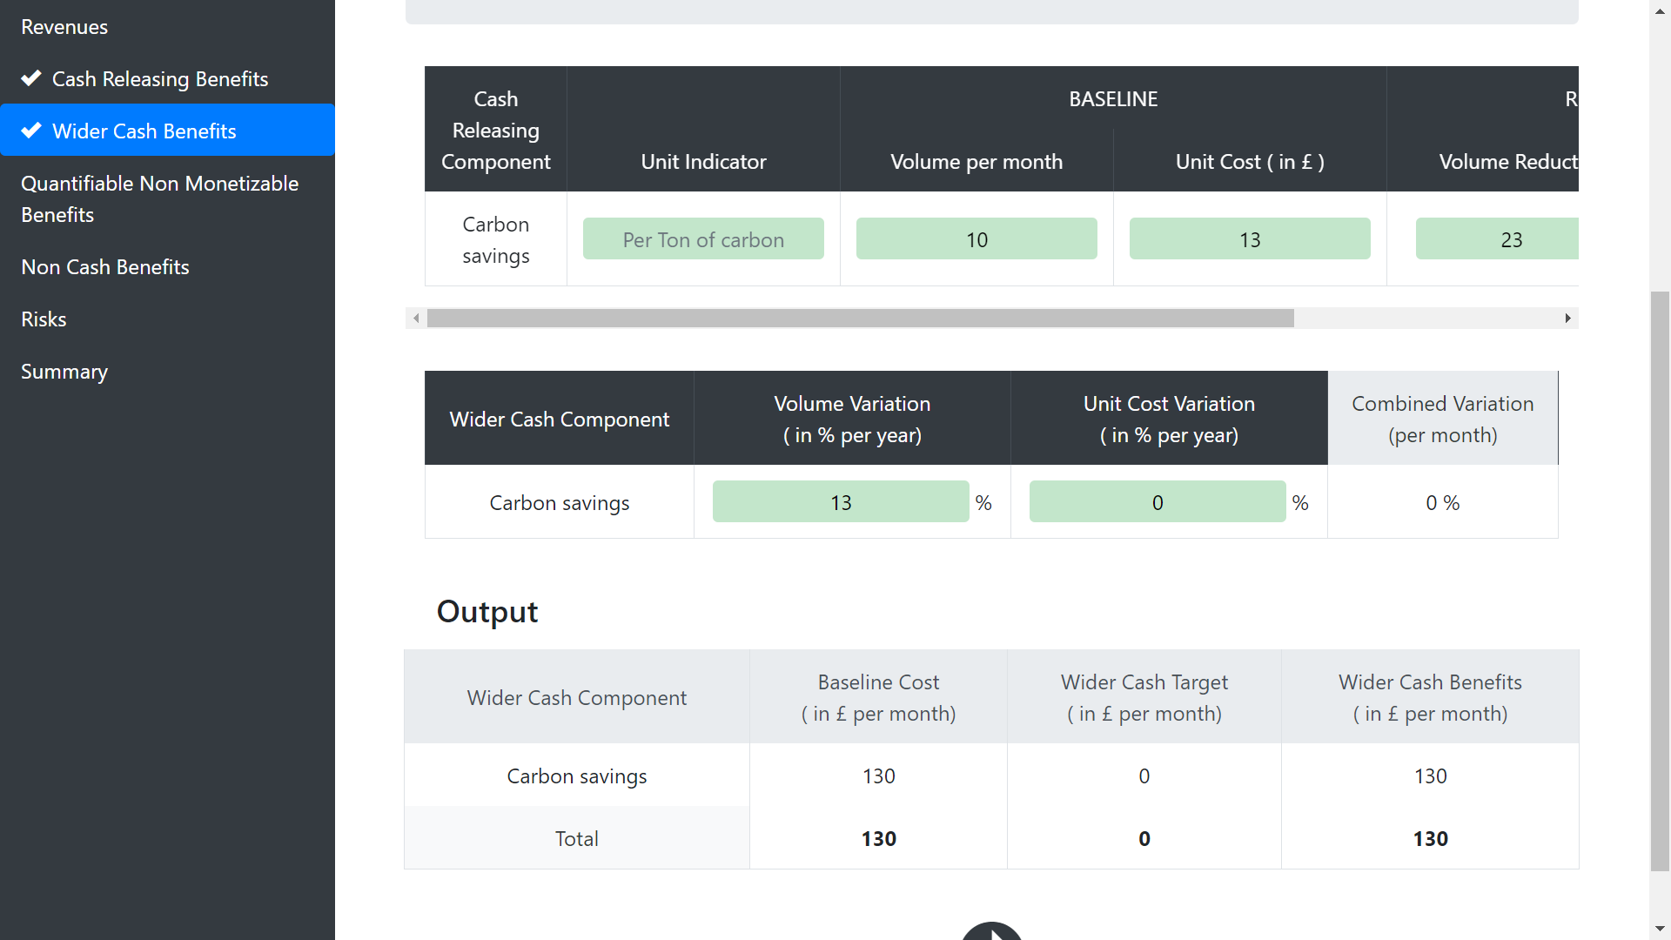
Edit this tables …
III Cost-Benefits
B - Cost Benefits
… and get the cash releasing summary.

Slide 38
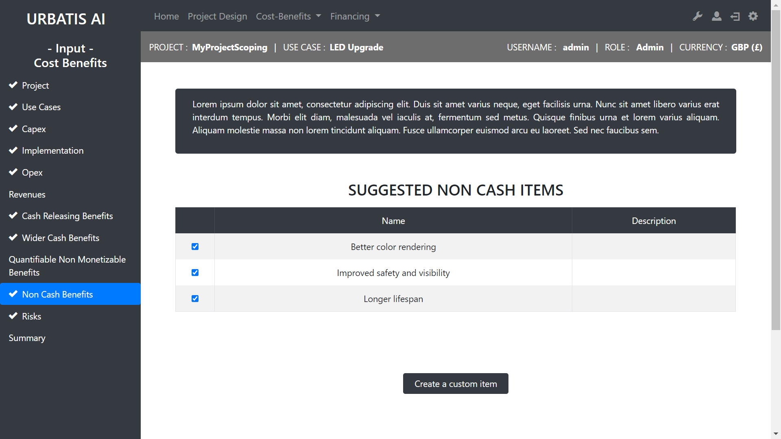
Select non cash items from our data base.
Create your own non cash item.

Slide 39
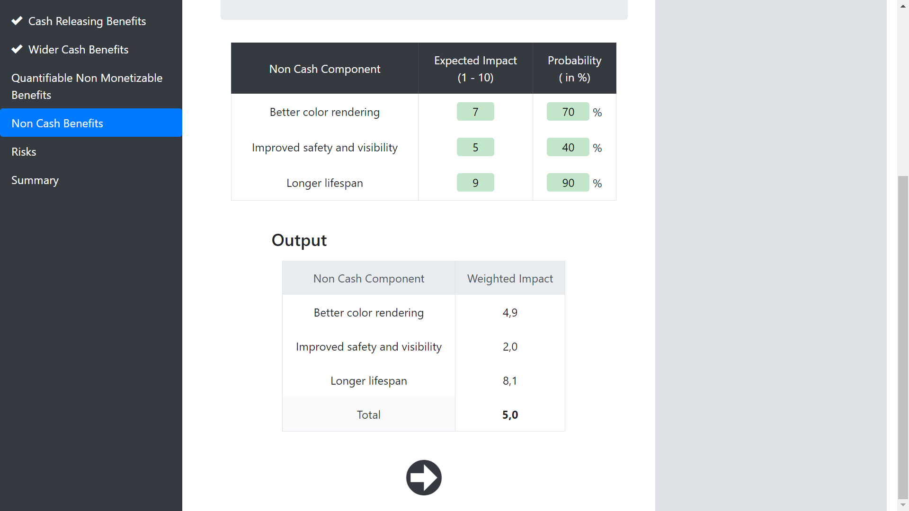
Edit this table …
… and get the non cash summary

Slide 40
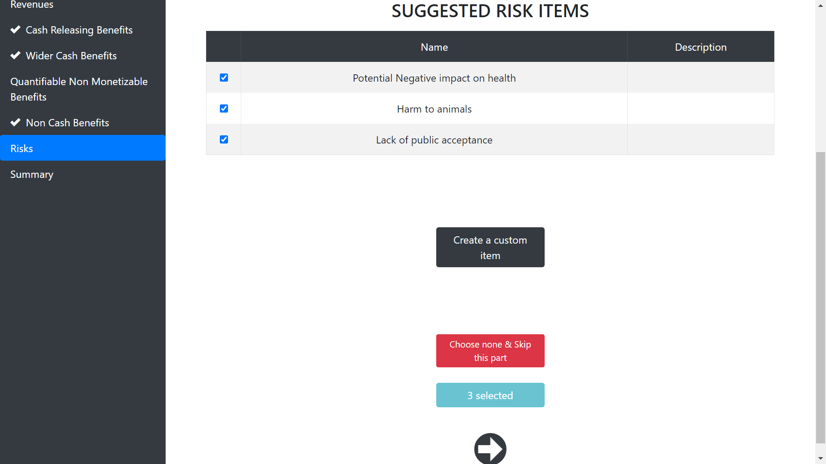
Select risk items from our data base.
Create your own risk item.

Slide 41
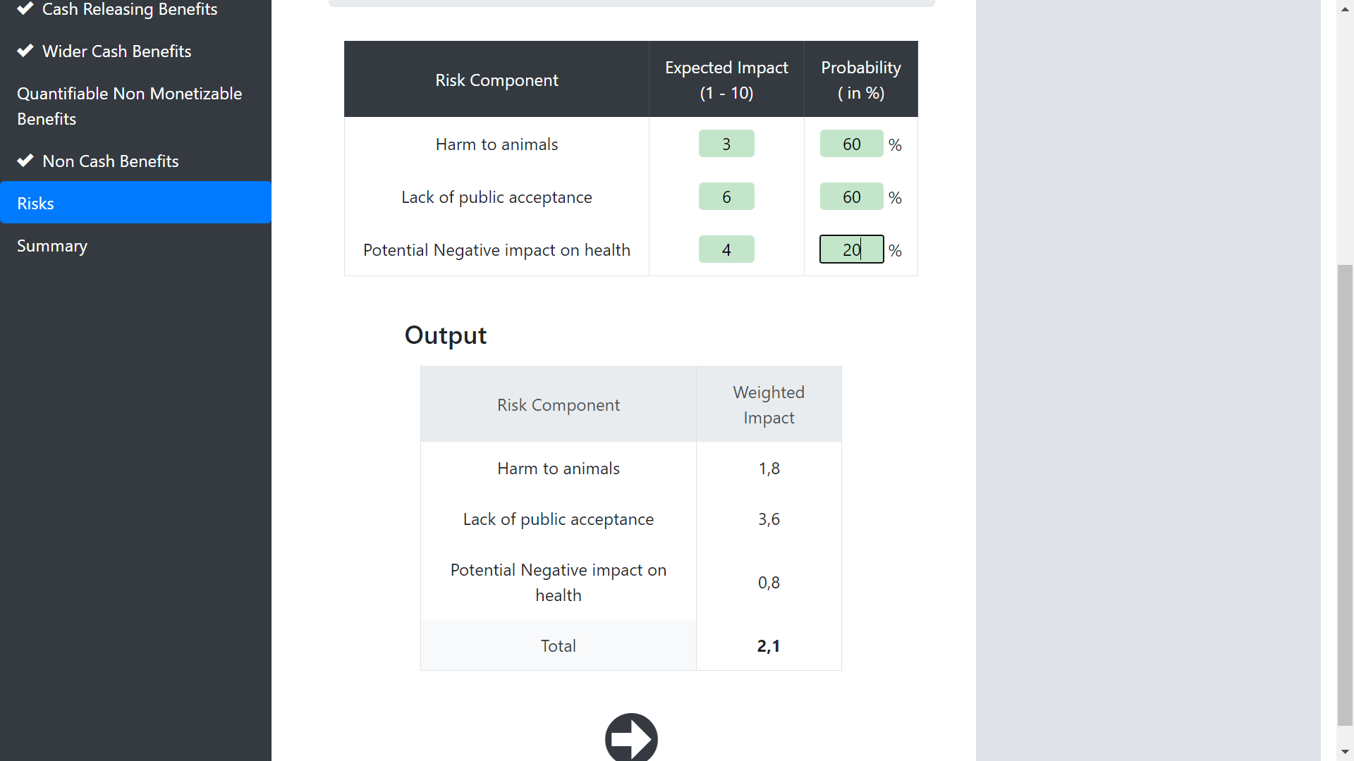
Edit this table …
… and get the risk summary.

Slide 42
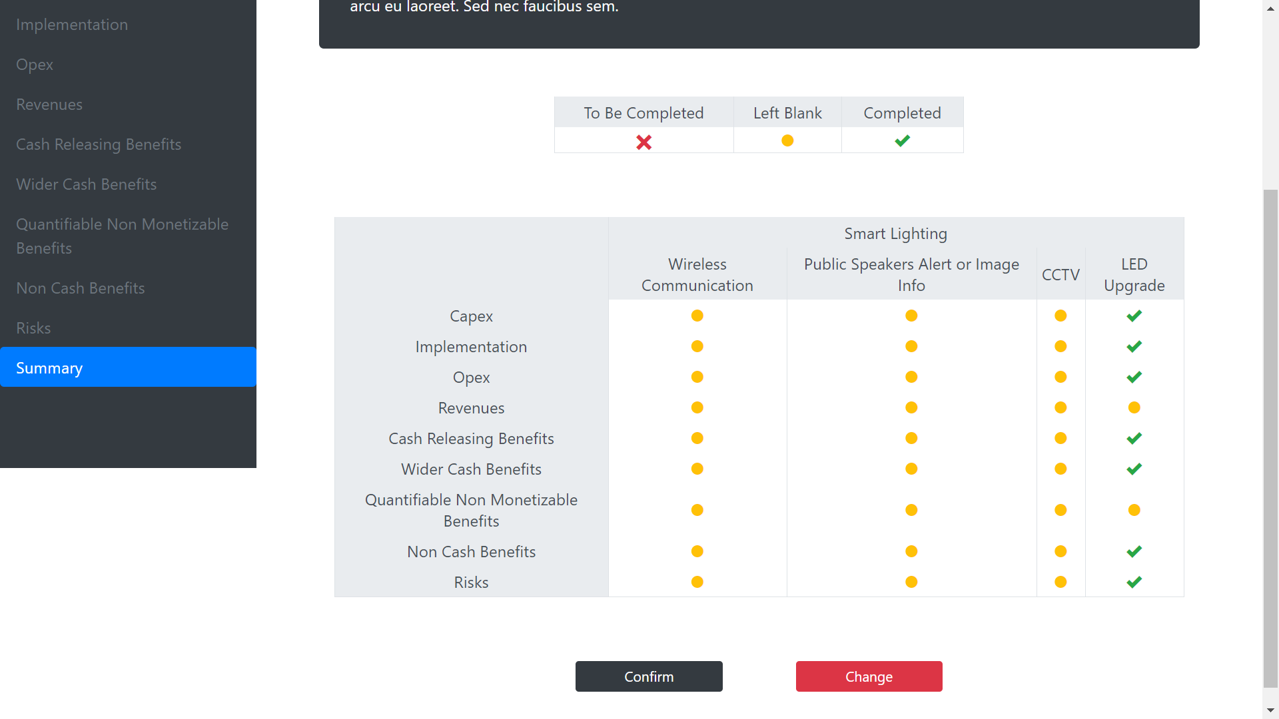
Finaly you have a summary of the information completed.

Slide 43
C - Dashboards
Back to summary

Slide 44
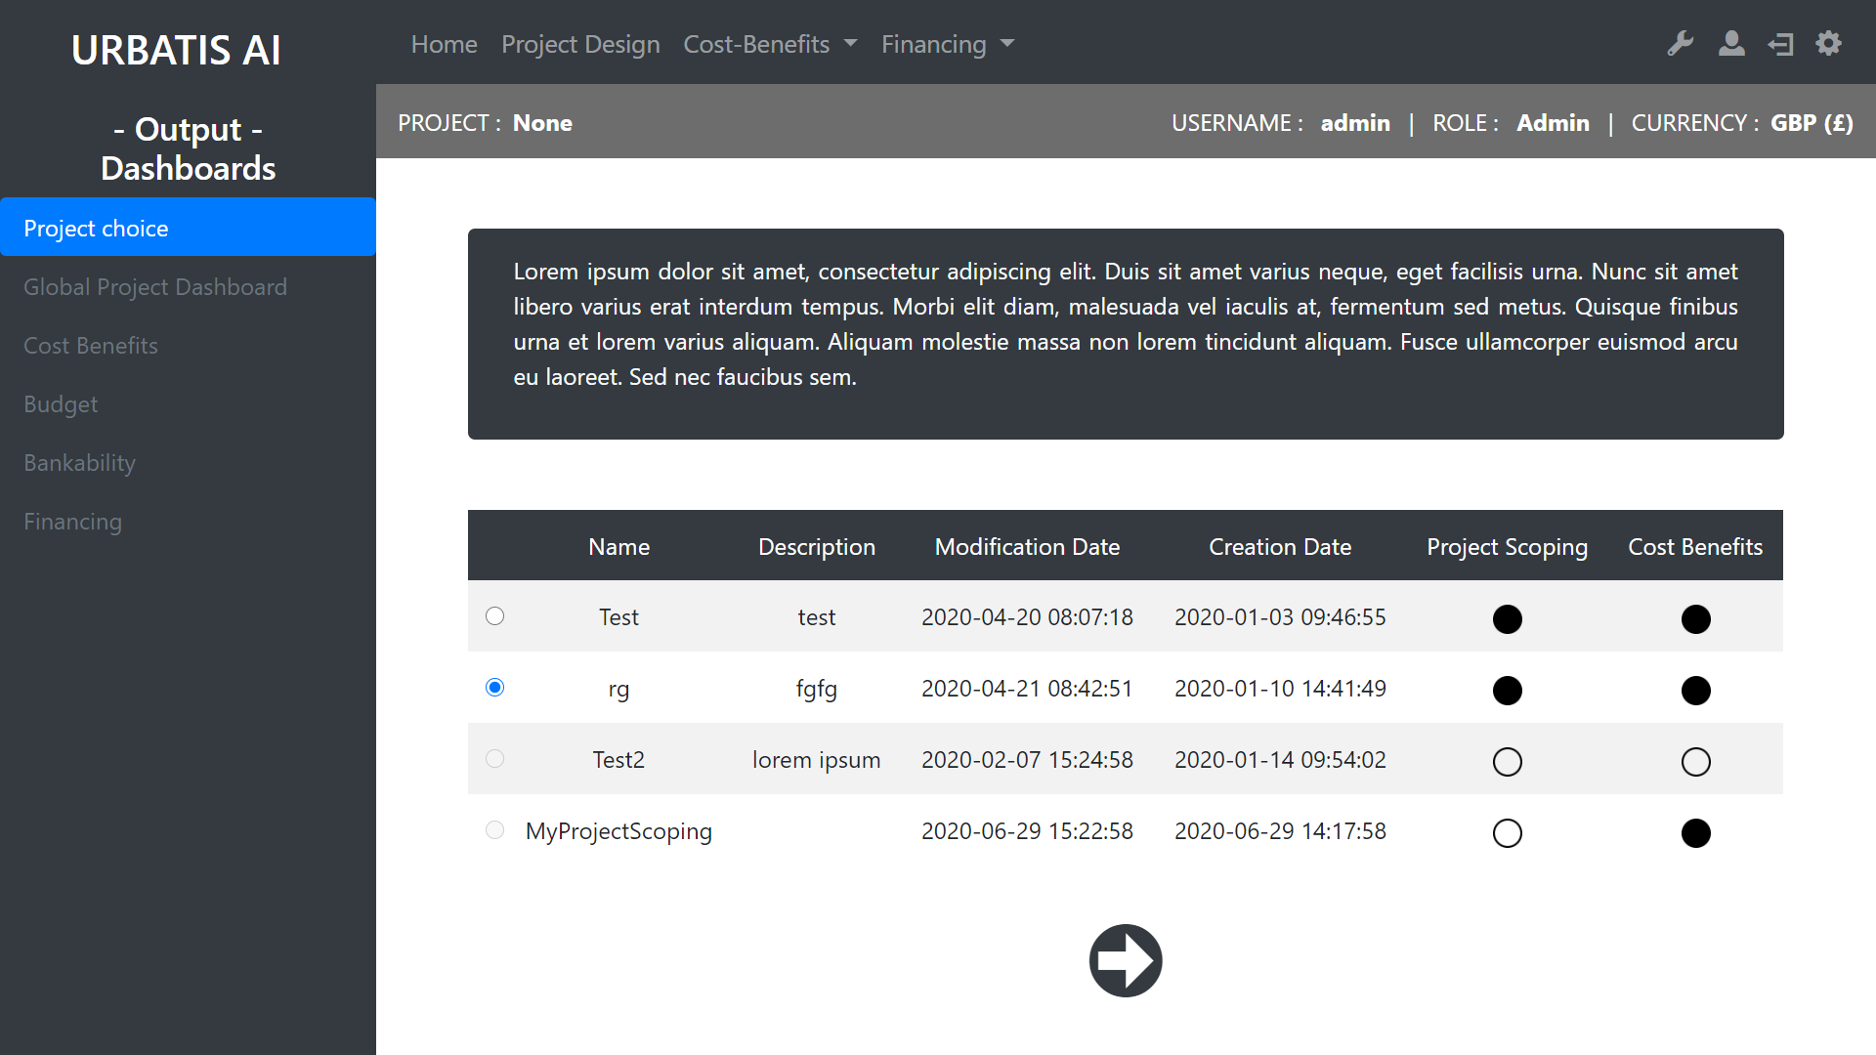
Select a project completed
Indicates wich part of the project is completed or not.

Slide 45
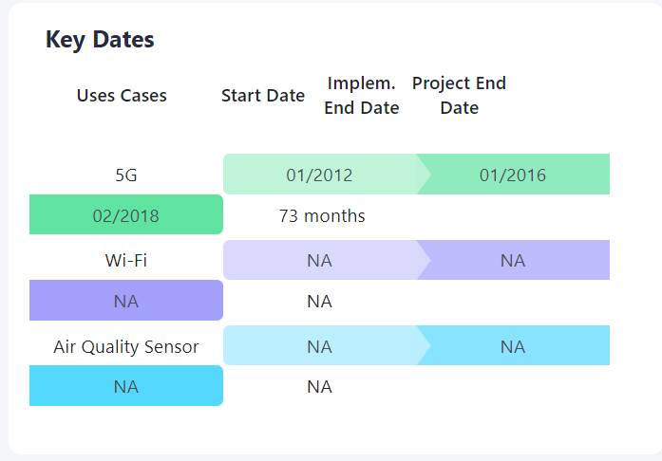
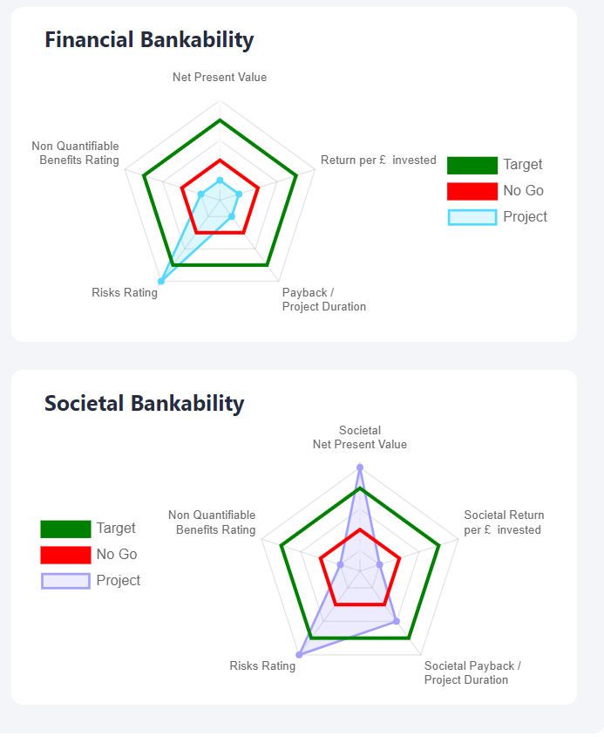
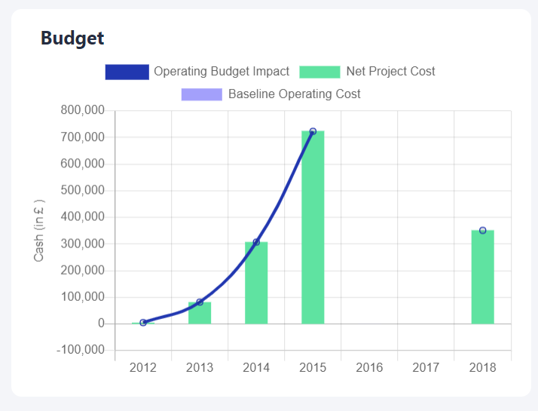
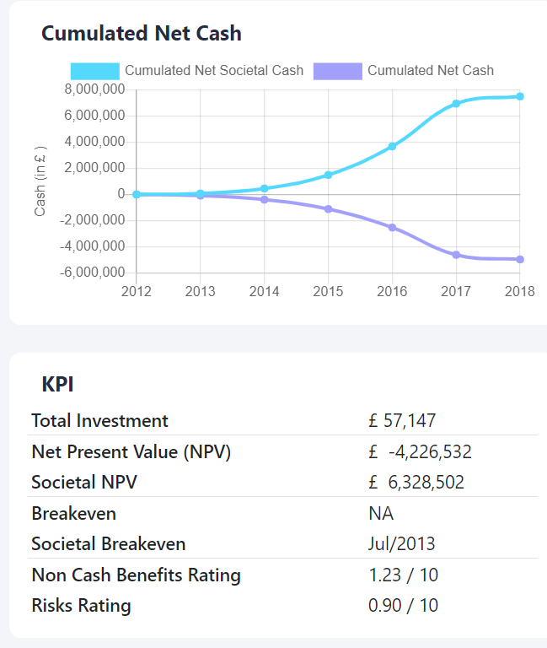
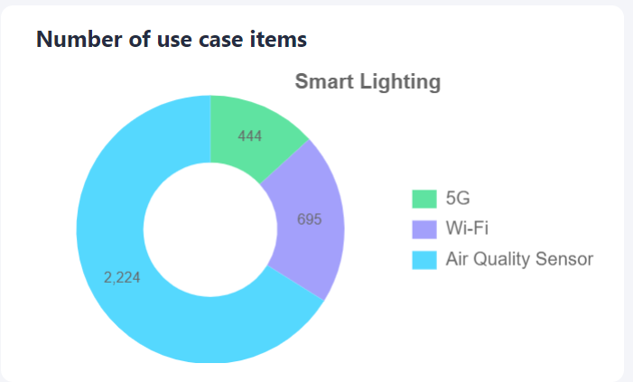
Global Project Dashboard : example of graph

Slide 46
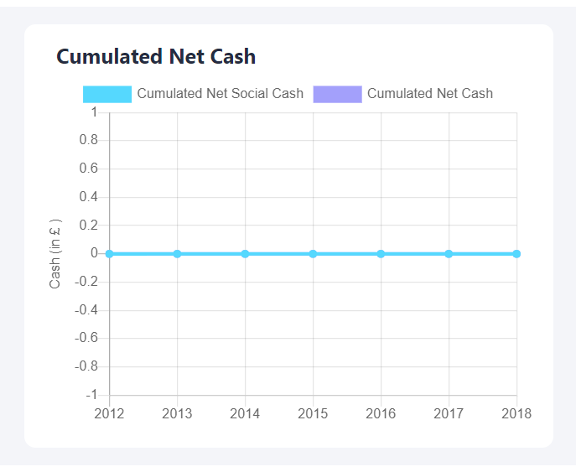
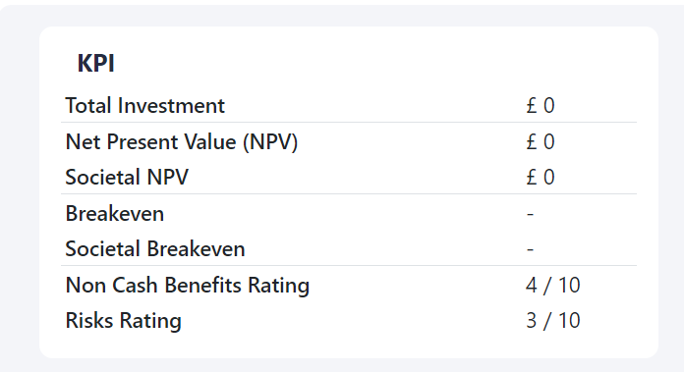
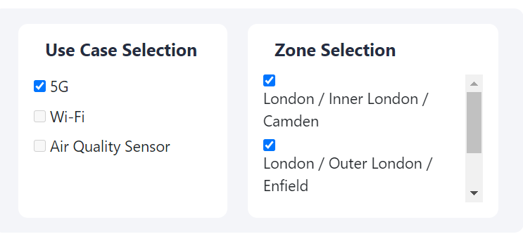
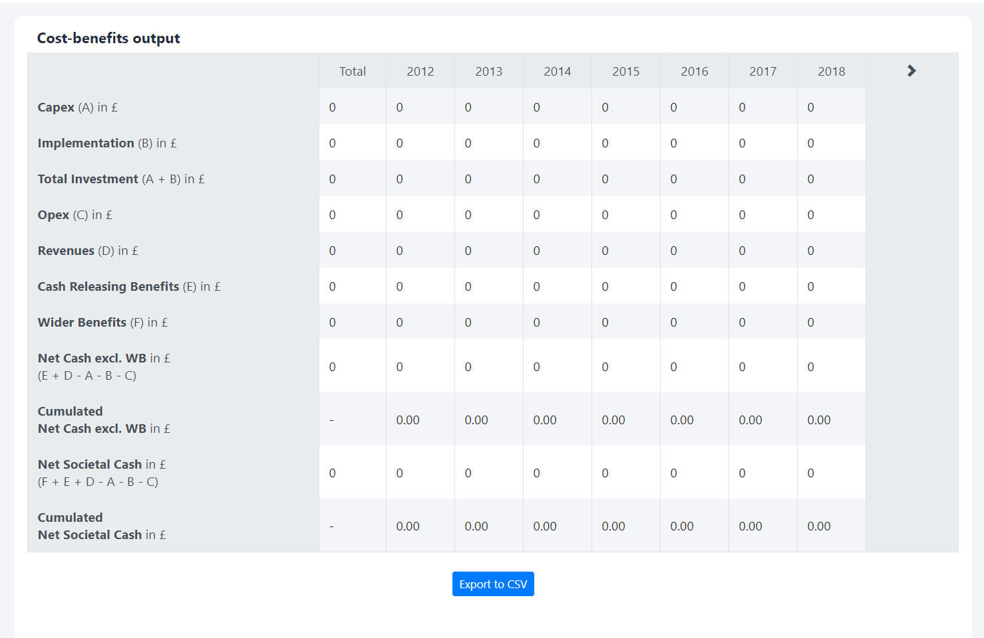
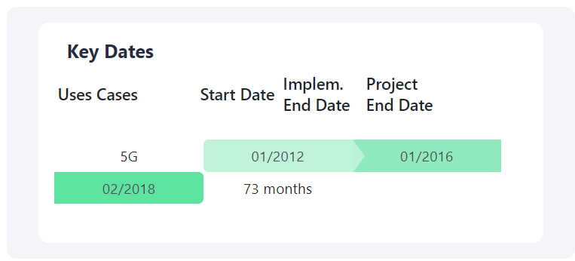
Cost Benefits Dashboard: example of graph

Slide 47
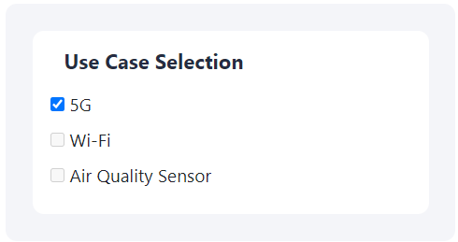
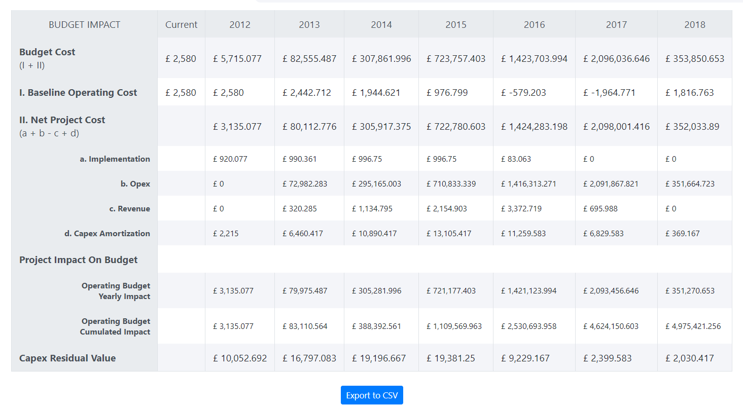
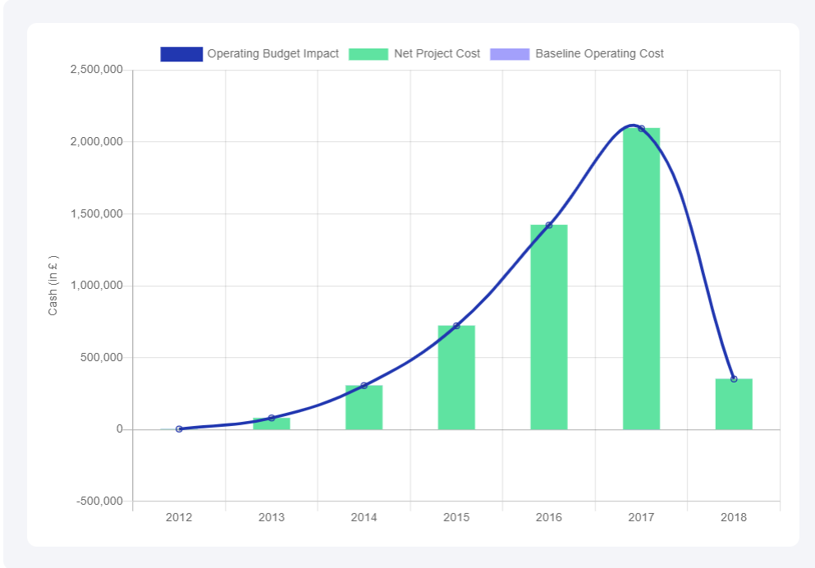
Budget: example of graph

Slide 48
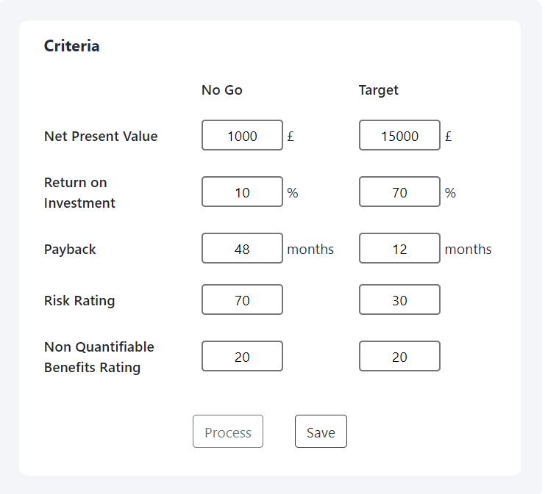



Bankability: example of graph

Slide 49

Select a Scenario.

Slide 50





Financing: example of graph

Slide 51
D- Comparison
Back to summary

Slide 52

With this sidebar you can navigate through the differents section of the Comparaison section.
With this butons you can navigate through the differents section of the Comparaison section.

Slide 53
1. Compare Projects
Back to summary

Slide 54

With this sidebar you can navigate through the different sections of the project comparison.
However, you can only access to white links. The grey links need more information to be activated.

Slide 55

Be sur that the scoping and the cost Benefits are fully completed for all the projects you want to compare.
Select the projects you want to compare.

Slide 56

You have a summary of the projects your are comparating.
Go to the next step.

Slide 57

Select some investment indicators.
Investment

Slide 58





Select some operations indicators
Compare the projects thank to the graphics

Slide 59


Select some operations indicators.
Compare the projects thank to the graphics.

Slide 60


Select some Non Quantifiable indicators.
Compare the projects thank to the graphics.

Slide 61







Select some Financial & Societal Components indicators.
Compare the projects thank to the graphics.

Slide 62
2. Compare Financial Scenarios
Back to summary

Slide 63


Slide 64


Slide 65
IV Financing
Back to summary

Slide 66
A - Funding
Back to summary

Slide 67

Create a new scenario.
Select a scenario.
Remove a scenario.
Go to the next step.

Slide 68

Go to the next step

Slide 69

You can select the Funding soures.
You can edit the share of total funding.
You can add or remove entites.
Go to the next step.
You have the outputs.

Slide 70

You can edit some parametres.

Slide 71

You know the fundinf of each beneficiary
You can ad or remove a beneficiary
You can edit the share of funding

Slide 72
B - Business Model
Back to summary

Slide 73

Select a project.
Go to the next step.
Be sur that the scoping and th cost Benefits are fully completed.

Slide 74

You can change some basic inputs
You have an interesting summary of your project

Slide 75
V Settings
Back to summary

Slide 76
A - Manage Database
Back to summary

Slide 77

By clicking on this wrench you will access to the manager of the database.
With this sidebar you can navigate through the differents parts of the database. You will be able to review and update all this sections.

Slide 78

Thank to this buton you can create a new element in the current table.
You can remove the elements of the table.
You see all the element of the current table.
Edit a table

Slide 79
B - Profile
Back to summary

Slide 80

By clicking on this buton you will be able to edit your profile’s informations.

Slide 81

You can change your username and your password.

